Slide 1
Jackson Legacy Bellwork
What did you decide about whether or not Jackson should be removed from the $20?
Answers Vary
What is one fact/piece of information that supported your decision?
Answers Vary

Slide 2
Objective
WWBAT: Introduce the background of the Abolition Movement and begin researching Black Abolition leaders

Slide 3
Interactive Notebook Setup
11/15/2018
Background on Abolition Movement
This will be one page

Slide 4
Abolition Background

Slide 5
Abolition
Let’s look at a definition
Abolitionism: The movement to end the slave trade and emancipate slaves
An abolitionist is:
a person who favors the abolition of a practice slavery

Slide 6
Abolition
Many of the leaders of the women’s rights movements came out of the abolitionist movement
Likewise many of the leaders of the abolitionist movement would also be prominent members of the women’s rights movement

Slide 7
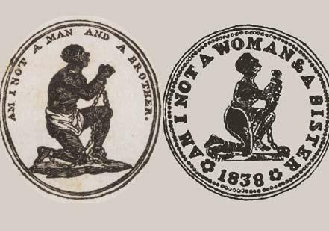

Slide 8
Abolition
“Political Abolitionism” was not so much opposed to slavery on moral grounds, because the slave state voting bloc and 3/5’s Compromise gave South so much political power
Focused on stopping the spread of slavery
The South felt that without slavery it would become a political minority, and as such, subject to the whim of Northern will

Slide 9
Abolition
Abolition for moral reasons was not common at the beginning
Many early WHITE Abolitionist supported gradual abolition and recolonization
These people still believed in white superiority even if they opposed slavery

Slide 10
Abolition
Many Black abolitionist wanted immediate abolition AND immediate Civil/Political equality
Some encouraging violent revolution
Some Black abolitionist also supported recolonization
Believing the racism created by slavery could never be overcome

Slide 11
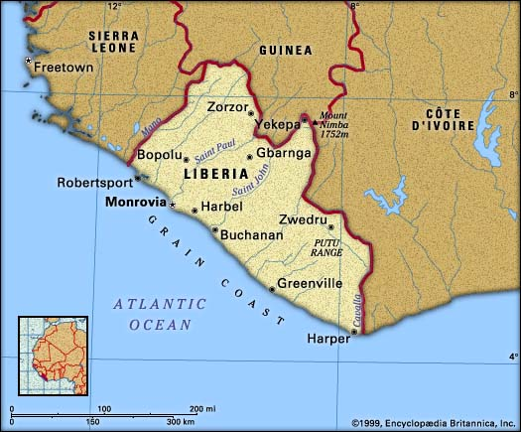

Slide 12
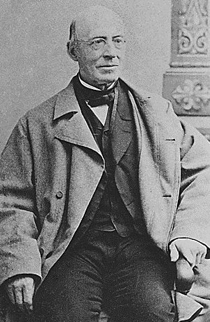
Abolition
William Lloyd Garrison helped popularize the idea that slavery was immoral as well as other more radical ideas
Lloyd Garrison published a paper called “The Liberator”
He organized nationwide speaking tours, founded abolition leagues, and ran for president from an Anti-Slavery party

Slide 13
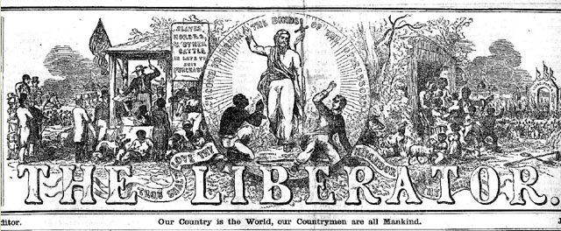

Slide 14
Abolition
Important Black abolitionist included:
Fredrick Douglas
David Walker
Maria Stewart
Sojourner Truth

Slide 15
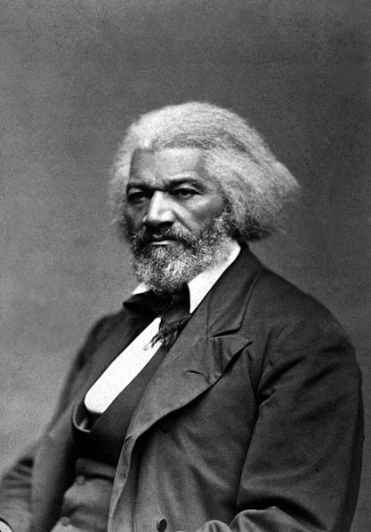
Fredrick Douglas

Slide 16
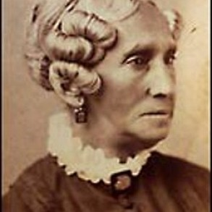
Maria Stewart

Slide 17
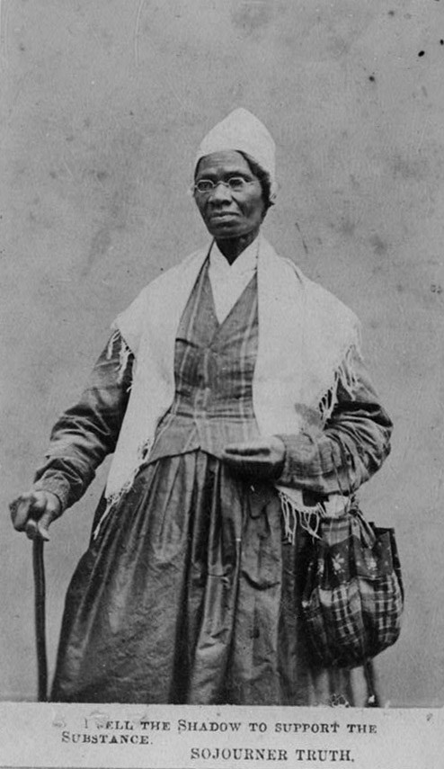
Sojourner Truth

Slide 18
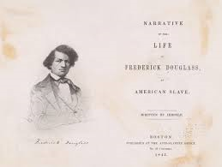
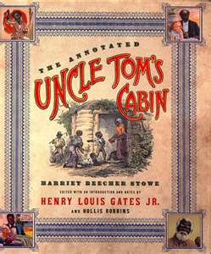
Abolition
Literature played a huge role in the growth of Abolitionism
Novels about slavery and more importantly slave narratives brought attention to the realities of slavery
Uncle Tom’s Cabin became one of the most widely read books in Northern States

Slide 19
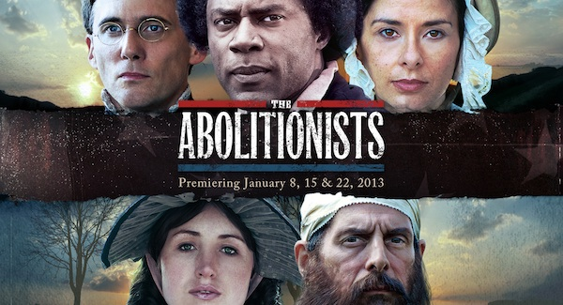

Slide 20
Abolition Bellwork
What was a major difference between white and black abolitionists?
White Abolitionist=Gradual Abolition
Black Abolitionist=Immediate Abolition and equal civil rights
What were the impacts of Novels and Slave narratives in the Abolition Movement?
Show people the realities of Slavery

Slide 21
Objective
WWBAT: Grade the Presidency of Andrew Jackson and continue researching Black Abolitionists

Slide 22
ONCE YOU FINISH
When you finish up:
Pick ONE of the five people you researched and print out a picture of this person
Print to 207HP600
You will then tape the picture to the front board and the inspirational/interesting fact you found about this person

Slide 23
Objective
WWBAT: Go to the lab to continue gathering info on black abolitionist

