Slide 2
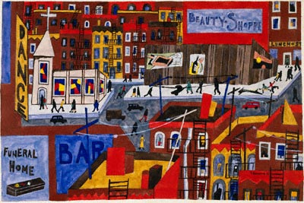
Black Nationalism Bellwork
How does this painting by Jacob Lawrence display Black Nationalism?
Black focus, displays black businesses, displays black neighborhood

Slide 3
Objective
WWBAT: Discuss the causes of the Great Depression and continue working on our project

Slide 4
Interactive Notebook Setup
4/9/2019
The Great Depression and Black Americans
This Will be on page

Slide 5
Causes of Depression
Depression and Black Americans

Slide 6
Lucky U.S.
The U.S. demonstrated one of its greatest strengths after World War One
IT IS NOT IN EUROPE!
The U.S. was still growing economically and now much of Europe was DEVISTATED!

Slide 7
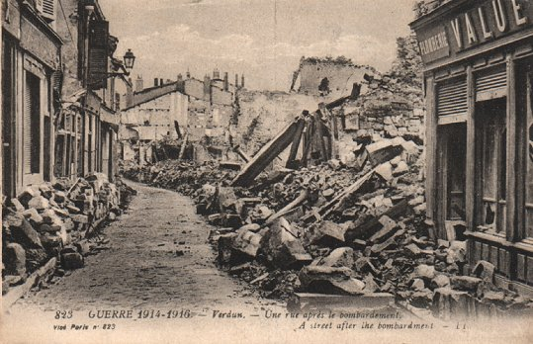
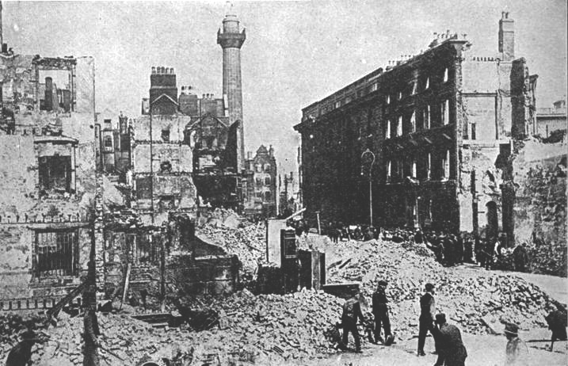

Slide 8
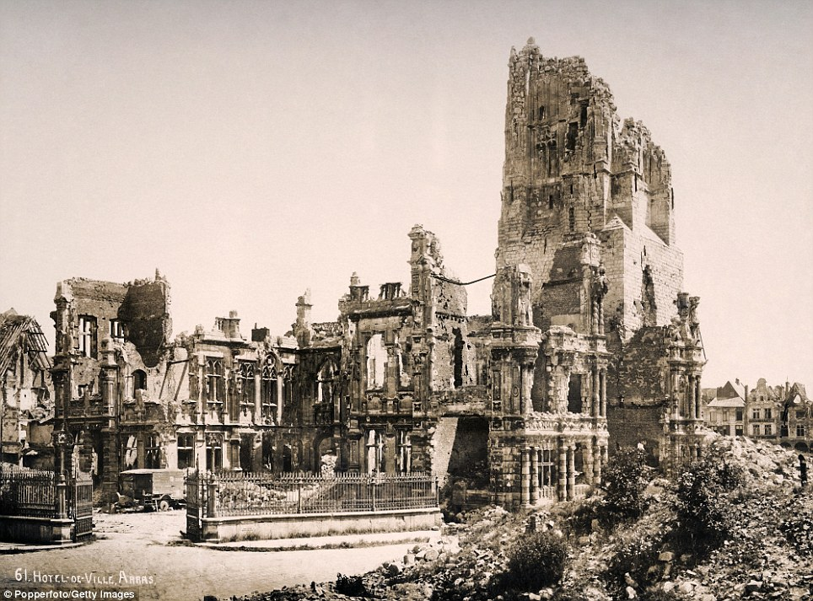

Slide 9
Lucky U.S.
U.S. companies were able sell goods, crops, and supplies in order to help Europe rebuild
The U.S. economy greatly benefited as a result
The U.S. government and banks also gave countless loans to European countries and companies
Which was not always the best plan…

Slide 10
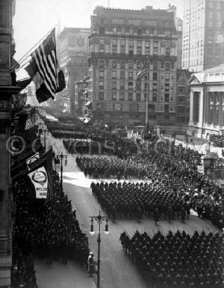
The U.S. After WWI
The U.S. had “won” the war!
And people in the U.S. FELT like they had won the war

Slide 11
Causes of the Great Depression
The U.S. economy had grown at unprecedented rates as a result of WWI
The U.S. barely fought in WWI
As a result of the war:
US factory and farm production grew
Average wealth of Americans grew

Slide 12
Causes of the Great Depression
American used this wealth and bought huge number of homes, stocks, cars, and appliances
ON credit

Slide 13
Consumer Economy
In the 1920’s credit changed forever
Because of more people working and people generally making more money credit was available to more
People were able to buy luxury goods on credit for the first time
Prior to this people had only used credit for emergencies and necessities

Slide 14
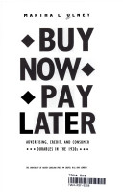
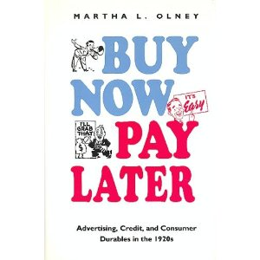
Consumer debt more than doubled between 1920 and 1930.

Slide 15
Consumer Economy
Items that were widely bought and used for the first real time included:
Washing machines
Irons
Gas ovens
Refrigerators
Radios
Phonographs
Cars

Slide 16
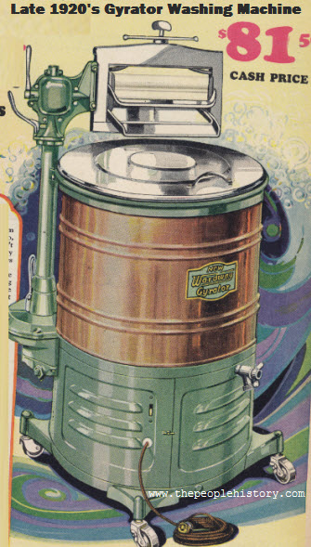

Slide 17
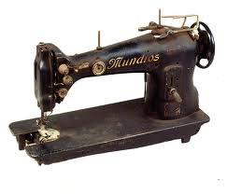

Slide 18
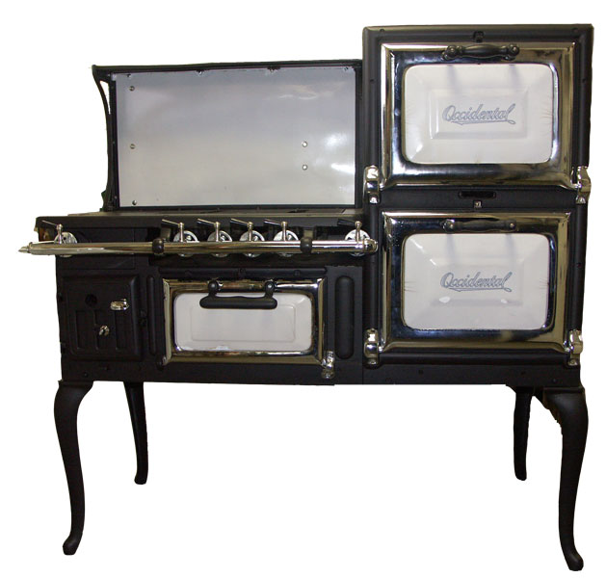

Slide 19
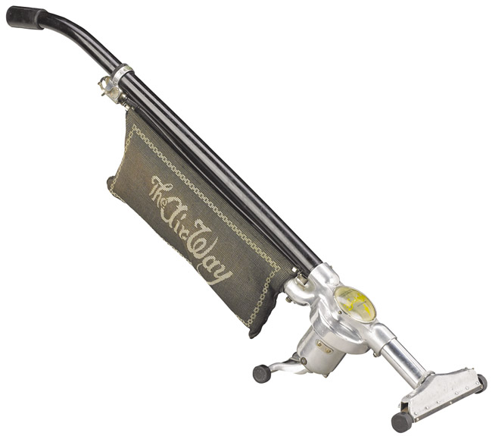

Slide 20
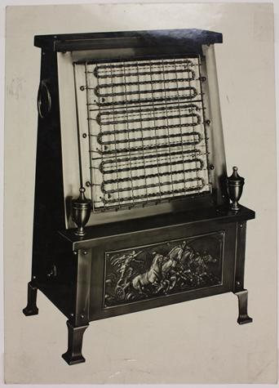

Slide 21
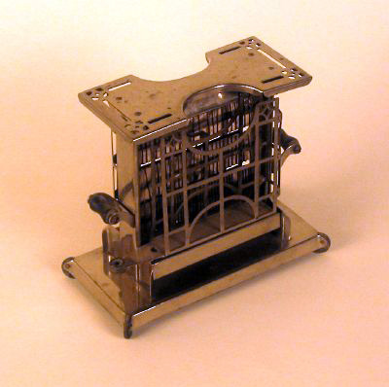
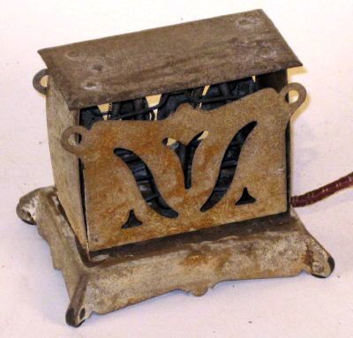

Slide 22
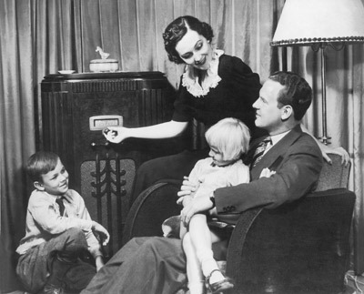

Slide 23
Motion Pictures
By the end of the 1920s, Americans bought 100 million movie tickets a week
The entire U.S. population was about 123 million people at that point
This past year Americans bought around a week 25,800,000 million movie tickets
The current U.S. population is around 311,000,000 people

Slide 24
Quotes About Movies
"I learned to kiss and hug at the movies. It was beautiful because it was innocent love and we learned it by watching movies, because otherwise, what would you do? My parents never kissed in front of me. Such things didn't happen."

Slide 25
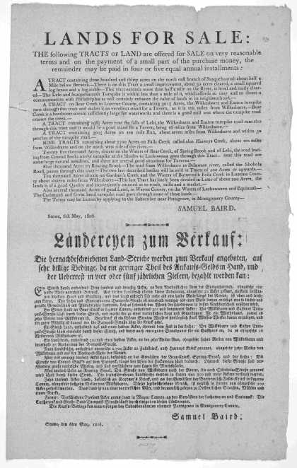

Slide 26
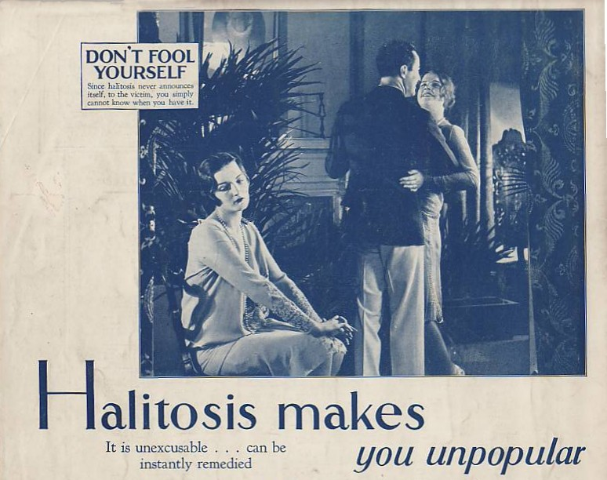

Slide 27
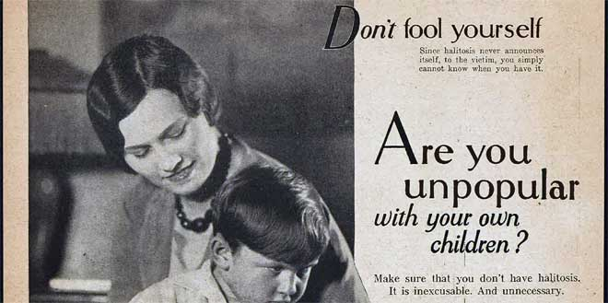
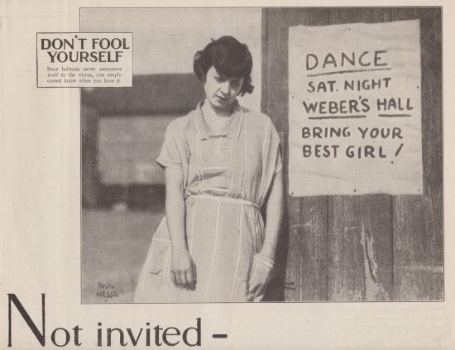

Slide 28
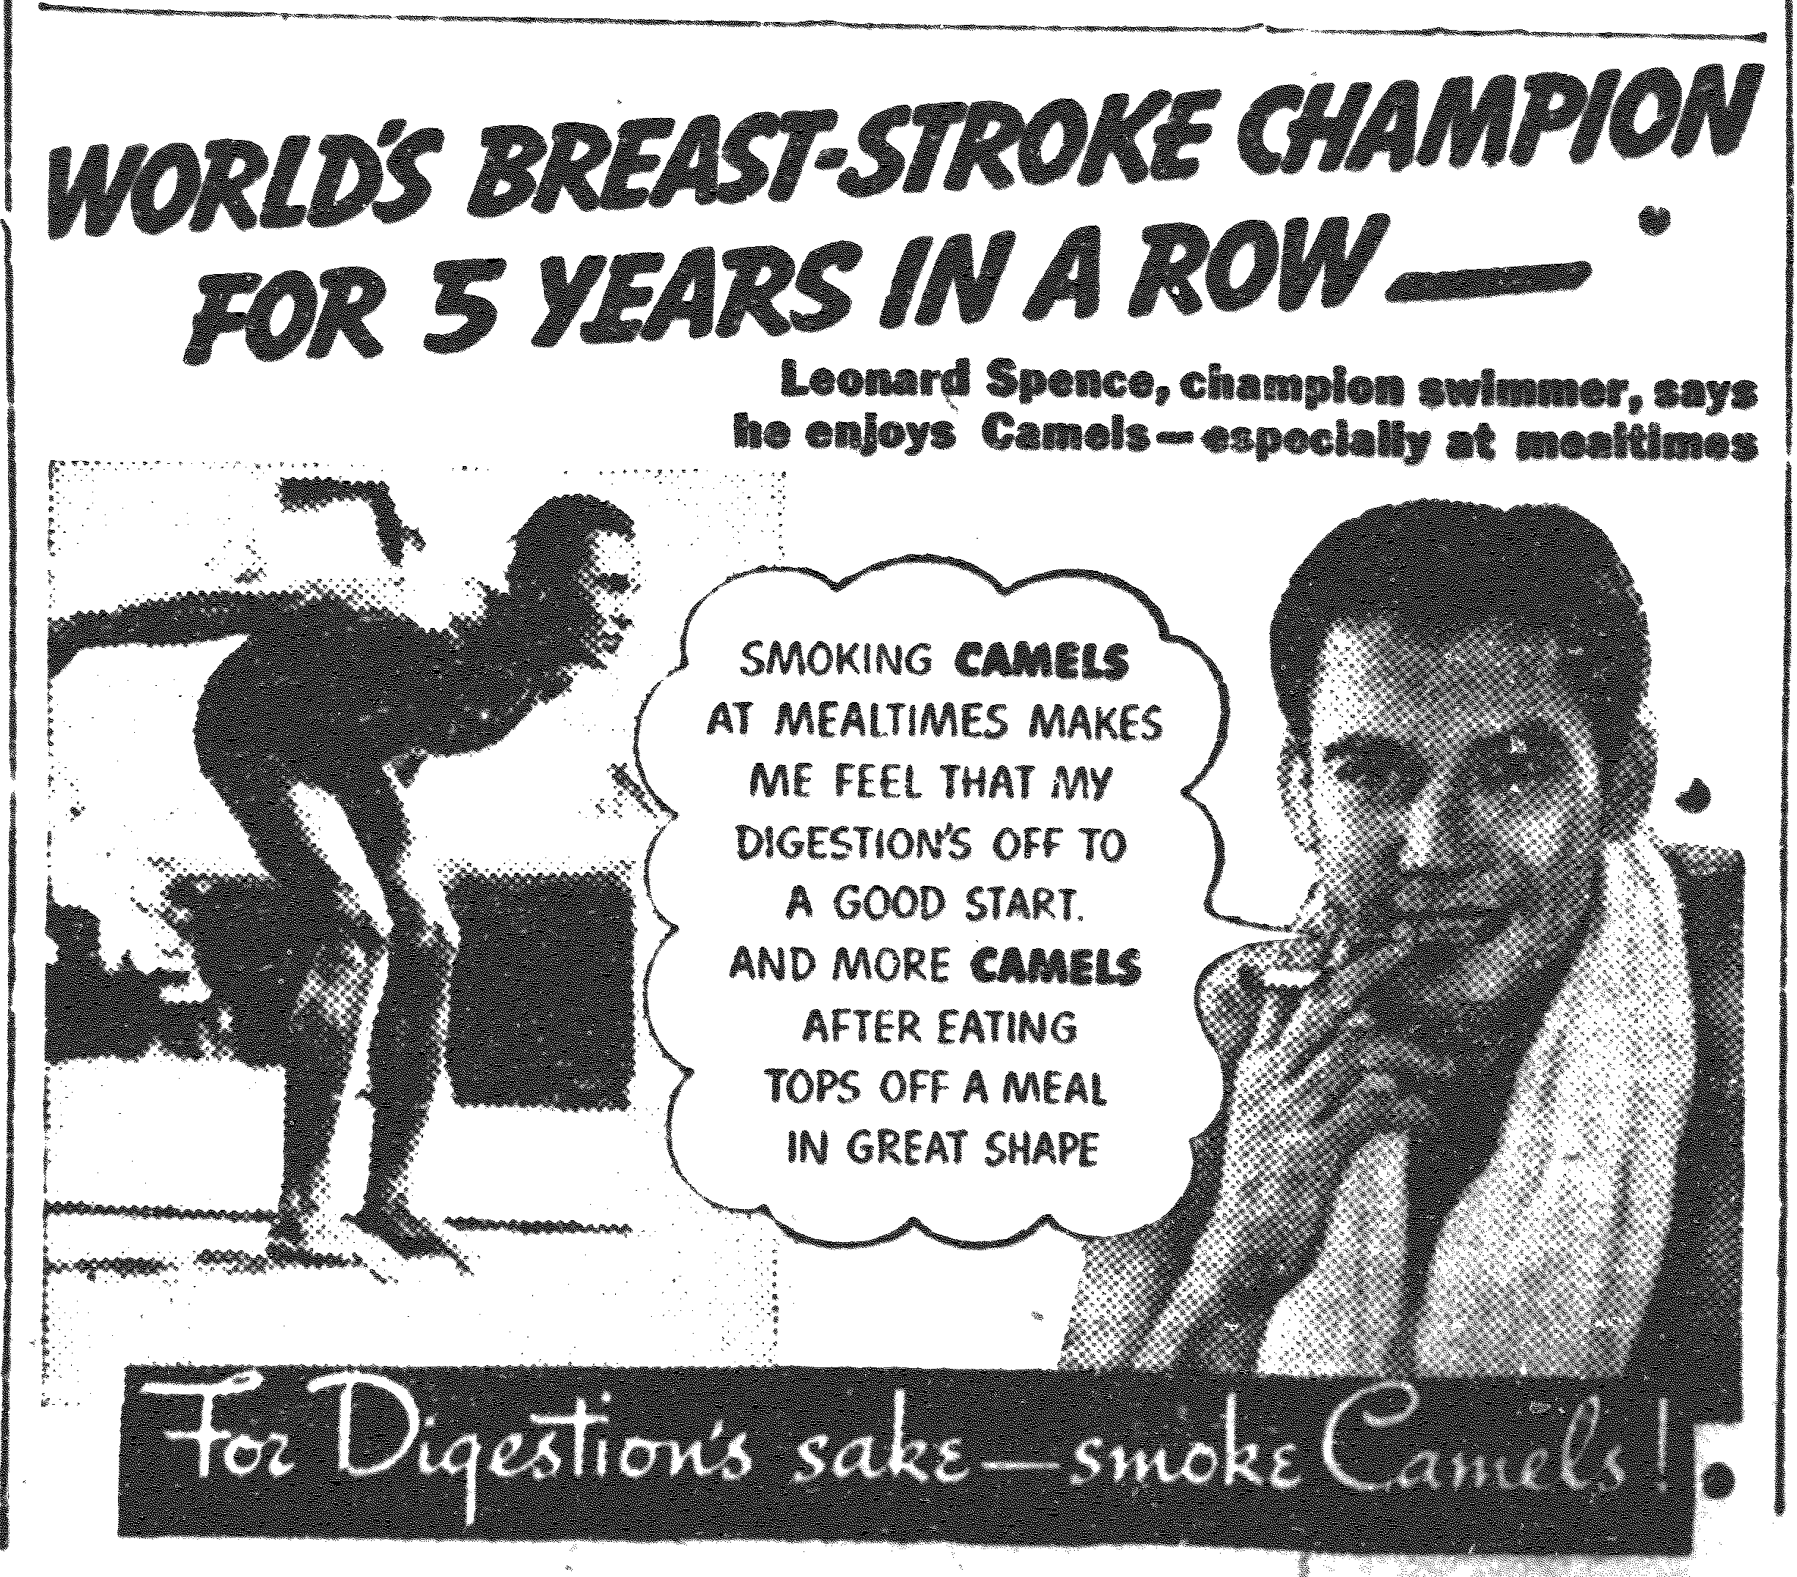

Slide 29
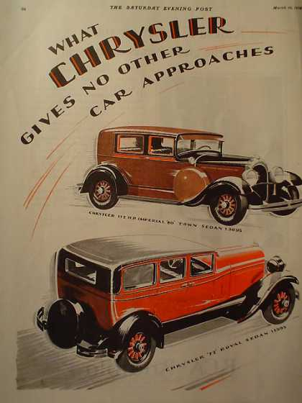

Slide 30
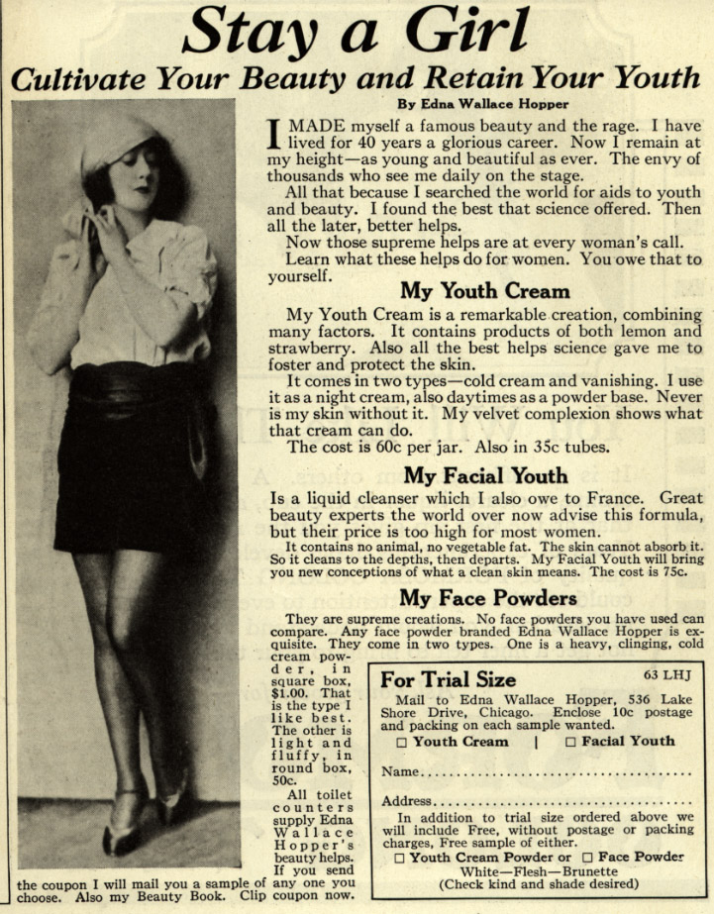

Slide 31
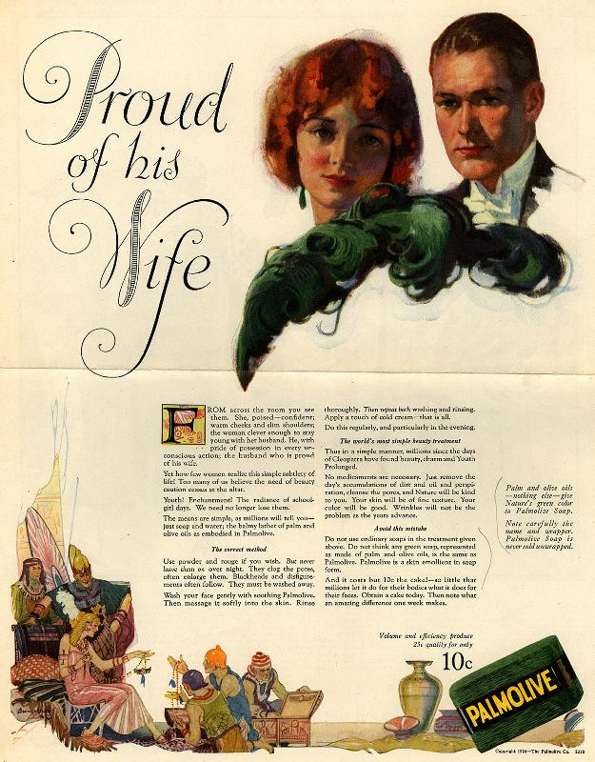

Slide 32
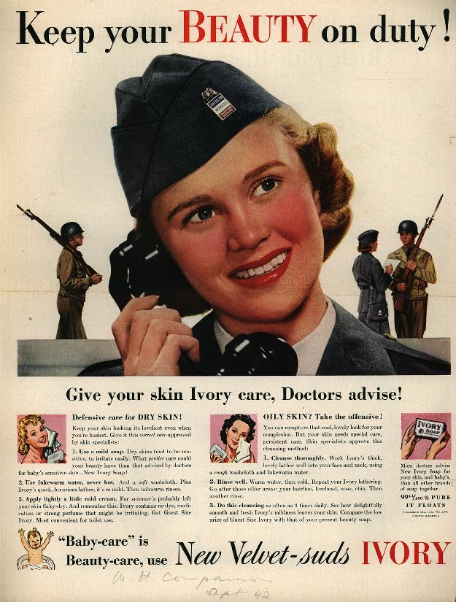

Slide 33
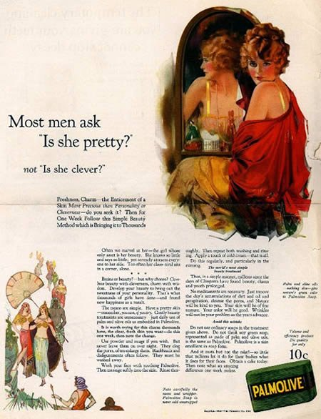

Slide 34
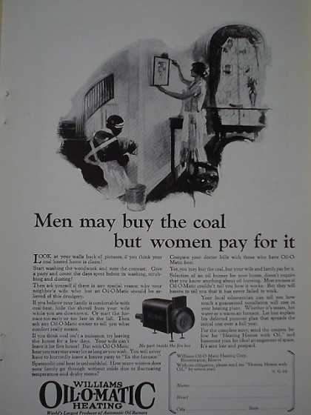

Slide 35
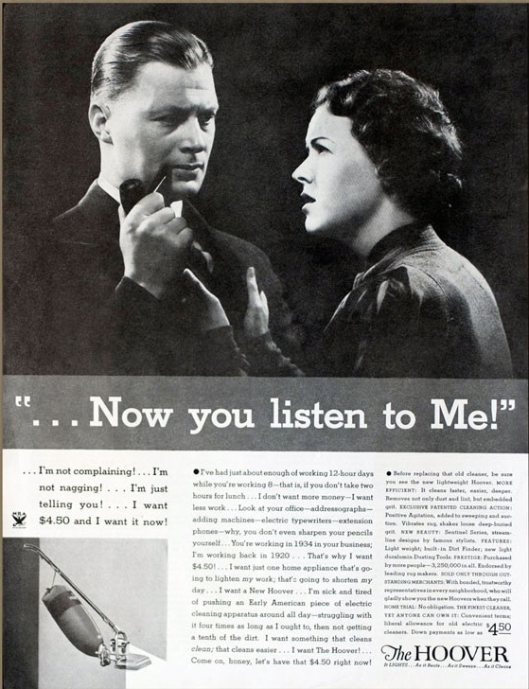

Slide 36
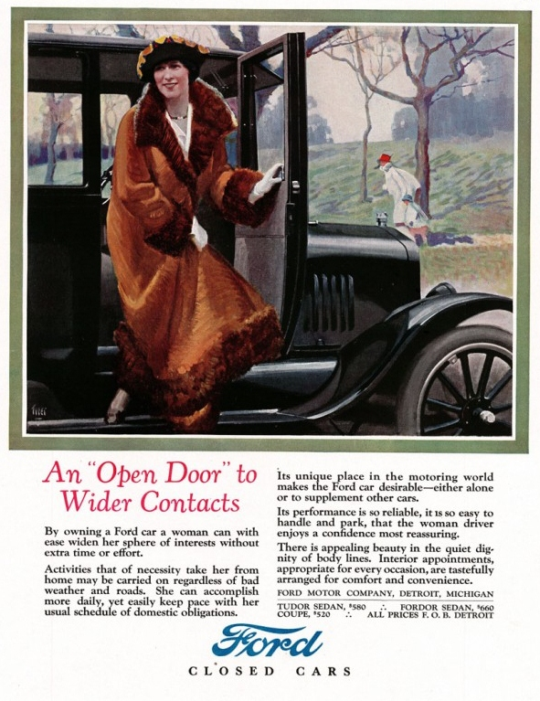

Slide 37
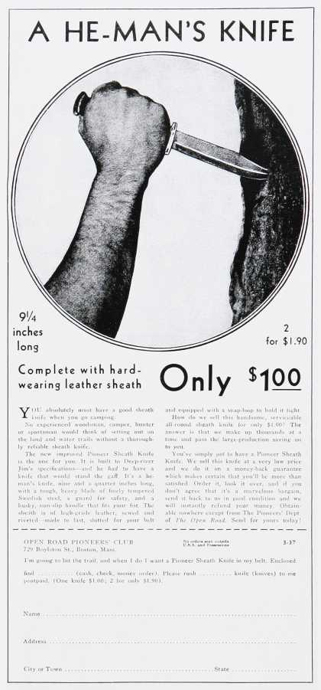

Slide 38
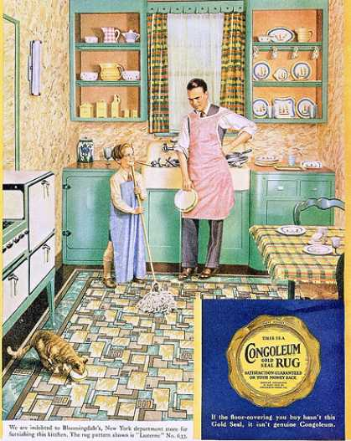

Slide 39
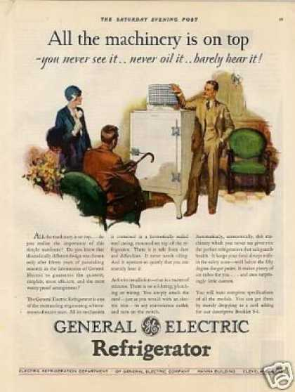

Slide 40
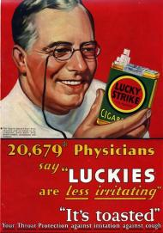

Slide 42
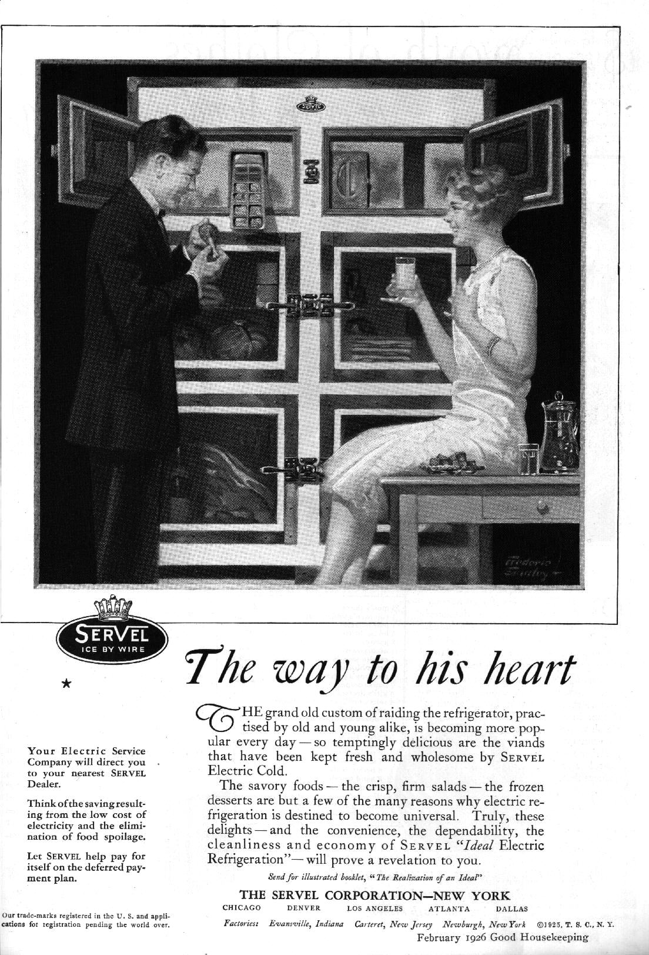

Slide 43
Slang Words
what you say when you are angry
"Oh, applesauce!"
Applesauce

Slide 44
Slang Words
The Big Cheese
the most important person
the boss
The Cat’s Meow
something splendid or wonderful
the best
Cheaters
eyeglasses
Jake
OK
Everything is Jake.

Slide 45
Slang Words
Dogs
Feet
Giggle Water
Alcohol
Heebie Jeebies
A Scary Nervous Feeling
Jalopy
An Old Car
Moll
A Gangster’s Girlfriend

Slide 46
Slang Words
Pushover
Someone easily convinced
Scram
Alcohol
Swell
Wonderful
Upchuck
Vomit
Whoopie
Have a good Time

Slide 47
Slang Words
Drugstore Cowboy
a fashionable man who spends his time in public places trying to pick up women
Cake-Eater
A ladies man
Stuck on
Infatuated with, have a crush on
an uninvited guest, a person who attends an event without paying admission
Gatecrasher
Hoofer
A chorus girl,dancer

Slide 48
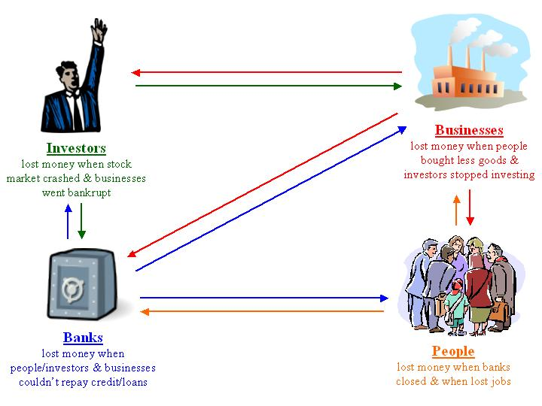
Why was the stock market crash such a big deal?

Slide 49
Causes of the Depression
Factories and farms continued producing at rates that could not be sustained after WWI
Supply outpaced demand
A family only needs so many radios, washing machines, cars, ect
Other countries stopped buying American goods

Slide 50
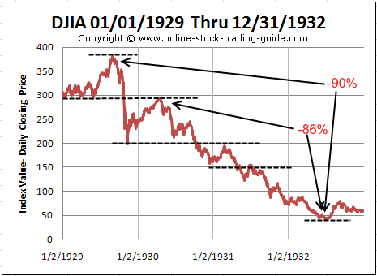
Causes of the Depression
Stock market was being run unfairly
weakened companies and banks

Slide 51
Causes of the Depression
Over farming in the Great Plains and South
Sustained drought happened throughout region
High winds blew away loose topsoil
A dust cloud approaches the town of Stratford, Texas, in 1935
Notes:
The Dust Bowl had three distinct causes:
Great Plains farmers, in an attempt to recoup losses from drastically declining farm prices, decided to plow more land in order to grow more crops for sale. Unfortunately, they didn’t understand the effect that increased supply and low demand would have on farm prices, and the increased cultivation only served to deplete land that could have been used for other purposes.
A lengthy drought struck the Great Plains, and soil already loosened and broken up from plowing now became even more parched because the smaller soil particles dried out more quickly.
A lack of geographical features to slow down air currents meant that the winds of the Great Plains could easily carry off valuable topsoil. The high winds blew the soil into the upper atmosphere, causing it to be transported over a great distance: soil from the Great Plains was found as far away as New England.
Certainly the state most affected by the dust storms was Kansas, while parts of Colorado, New Mexico, Texas, and Oklahoma were also hit hard.

Slide 52
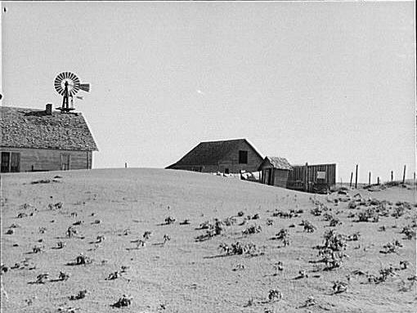
Causes of the Depression
More than 500,000 Bowl left homeless by Dust
Storms blew large amounts of dust from the Plains into cities such as Chicago and Buffalo
“Red snow” fell on towns in New England
Notes:
The impact of the Dust Bowl was substantial. Nearly a half-million people were displaced as a result of the catastrophe. Related storms moved large amounts of dust from the Great Plains to the eastern United States. Chicago experienced a greater deluge than any snowstorm, as more than four pounds of dust per person fell on the city in the summer of 1934. Red and black snow fell in New England, as dust mixed with normal precipitation during the winter of 1934–1935. In some instances, persons reported near-blackout conditions with visibility of less than five feet.

Slide 53
Statistics of the Great Depression
The average income of the American family dropped by 40 percent from 1929 to 1932
Income fell from $2,300 to $1,500 per year
(In 2017 dollars=$32,924 down to $21,472)
Unemployment rate was at 16.3% in 1931 and rose as high as 25%
Today the unemployment rate is 4.5%
By the beginning of the 40’s more than 2.5 millions people had left the Great Plains
Around 200,000 went to California
100,000,000 acres were affected

Slide 54
Crazy Facts
Zippers became widely used because buttons became too expensive.
Because the circulation of money was so low, the U.S. didn't mint nickels in 1932 or 1933

Slide 55
The Plight of the “Okies”
Farmers from Oklahoma fled the Dust Bowl
Went to California for farm jobs
Possibly 15 percent of Oklahoma’s population became migrants
A woman and her child rest beside their car during their trip west
Notes:
As the misery of the Dust Bowl intensified, many farmers in the worst-affected areas left, looking for a fresh start. Many packed everything they owned into cars or trucks and went west to California.
The “Okies,” as they were frequently called, moved en masse toward the West Coast. By some estimates, as much as 15 percent of the population of Oklahoma left in search of a better life.

Slide 56
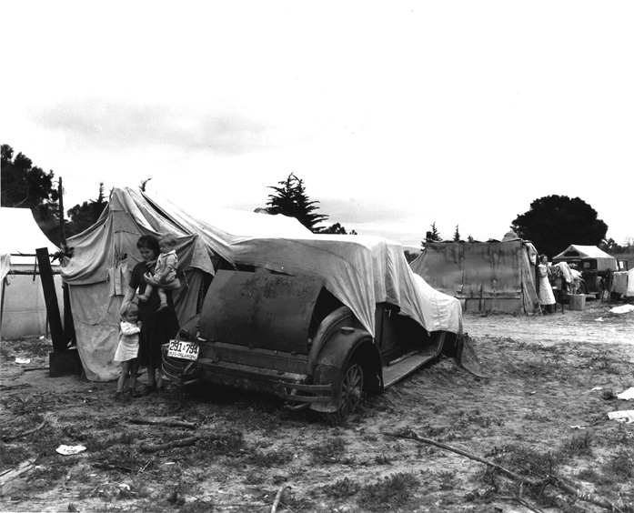
Hardships
“Camps” unsanitary
Wages decreased for large numbers
California passed an “anti-Okie” law
A migrant camp in California
Notes:
As more and more “Okies” moved westward looking for work, they found deplorable conditions in the migrant camps where they settled. Frequently, these camps did not have running water or proper sewage facilities, and illness was rampant because of contaminated water. Camps also suffered from overcrowding, which made disease and unsanitary conditions even more likely.
Dispossessed farmers looking for work also caused an overabundance of labor in states already swamped with farm workers. Because jobs were extremely difficult to come by, growers needing migrant labor could easily offer to pay substandard wages, and workers desperately needing jobs would have no choice but to accept such wages. At a time where jobs were extremely difficult to get—particularly in the farm sector—workers were willing to accept any wage they could get.
In some states, the influx of migrant labor inflamed tensions between the migrants, the residents of those states, and state governments. Residents of states such as California were resentful of the Okies because they competed against them for scarce jobs. In 1937, California went so far as to pass an “Anti-Okie” law which made it a misdemeanor to knowingly “import” an indigent person to the state for work. While the law was eventually declared unconstitutional, many saw it as a necessary step to protect jobs and resources for California residents.

Slide 57
The “Migrant Mother”
One of the most famous New Deal–era photos
Shot for the Resettlement Administration by Dorothea Lange
Taken in California in February or March 1936
Notes:
The “Migrant Mother” is one of the best known of all pictures shot by New Deal agencies, and has come to symbolize the suffering of the Dust Bowl. This photo of a migrant woman with three of her seven children was shot by Dorothea Lange for the Resettlement Administration. Lange commented on the photo:
“I saw and approached the hungry and desperate mother, as if drawn by a magnet. I do not remember how I explained my presence or my camera to her, but I do remember she asked me no questions. I made five exposures, working closer and closer from the same direction. I did not ask her name or her history. She told me her age, that she was 32. She said that they had been living on frozen vegetables from the surrounding fields, and birds that the children killed. She had just sold the tires from her car to buy food. There she sat in that lean-to tent with her children huddled around her, and seemed to know that my pictures might help her, and so she helped me. There was a sort of equality about it” (Popular Photography, Feb. 1960).

Slide 58
The Day the Bubble Burst
October 29, 1929
More than 16 million shares traded in one day
Stock market lost $30 billion
Beginning of the “Great Depression”
The trading floor of the New York Stock Exchange in 1929
Notes:
While the fundamental causes of the Depression took years to lead to financial calamity, many point to a single day when the Depression began: October 29, 1929, when the stock market crashed. On that day, more than 16 million shares were traded (a record at the time) and the market lost $30 billion—nearly the amount the U.S. had spent fighting World War I. While the market had rapidly increased in value from 1927–1929 (approximately 140 to 360 points), it fell nearly more than 100 points in the months after the crash. As the Depression worsened, the market hit a low of approximately 40 as the election of 1932 loomed, and did not approach the 100 mark again until after Franklin D. Roosevelt’s inauguration.
By the time Roosevelt took office, stocks had lost 80 percent of their total value. Confidence in the market declined sharply as former investors felt betrayed and unwilling to buy stock. Since they refused to purchase shares, much-needed investment and expansion did not occur, which further hampered economic recovery.

Slide 59
Banking System Collapse
Banks invested heavily in the market
Collapse of market led to bank failures
Many depositors panicked, leading to even more bank failures
Worried depositors wait outside a bank hoping to withdraw their savings
Notes:
While many investors lost their money in the market, many other people found their savings wiped out because banks had irresponsibly invested depositors’ money in the market as well. Therefore, when the crash occurred banks also lost millions.
Banking was already a risky business, with more than 600 banks failing every year from 1920–1929. Following the stock market crash, however, bank failures jumped dramatically. Between 1930 and 1933, nearly 10,000 banks failed nationwide, with 4000 failing in 1933 alone.
Unfortunately for these banks’ depositors, there was no national “safety net” to protect their money. While some states did have insurance programs for bank deposits, bank failures in the period before the crash had essentially wiped out those programs, leaving depositors completely unprotected.

Slide 60
Depression and Black Americans
Manufacturing-based economy in the North, black workers lost jobs at higher rates than white
Many factories/companies were likely to fire non-white employees first
Many lost jobs gained during the Great Migration
Domestic workers lost their jobs when their employers could no longer pay them
African American communities had some of the highest unemployment rates in the country during the Depression
50% compared to at white unemployment rate of closer to 25%

Slide 61
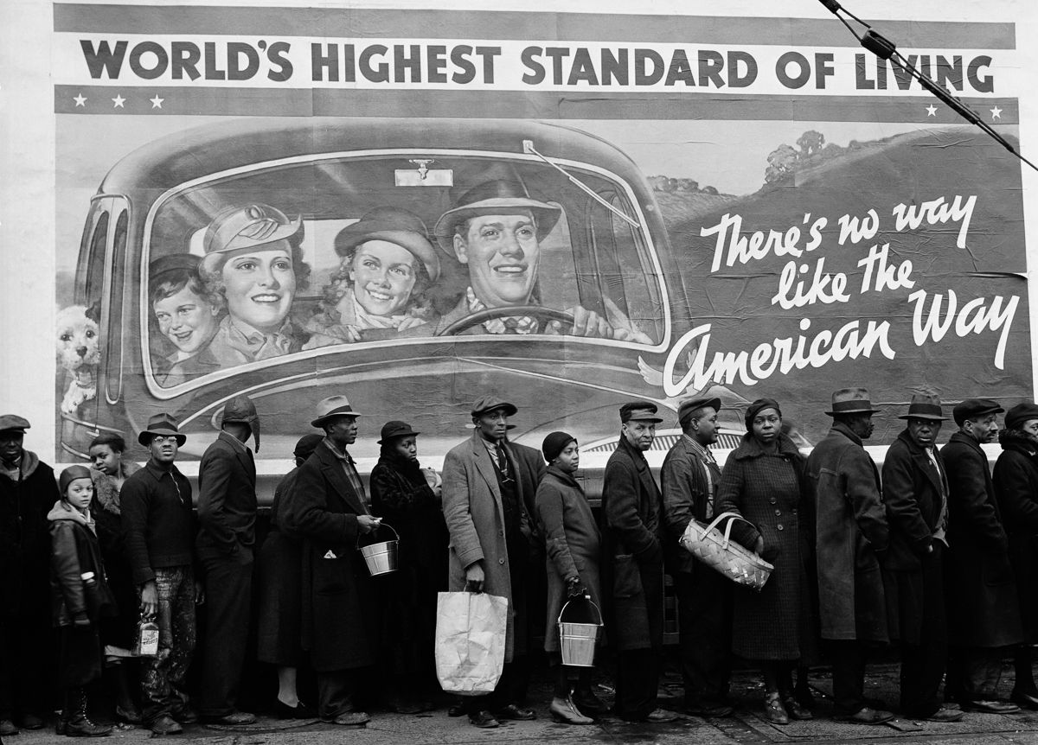
Depression and Black Americans
African Americans barred from some relief—religious and charity organizations; government jobs for white applicants only

Slide 62
Depression and Black Americans
Black farmers lost much of the land gained over the last three decades
Lost farms at a higher rate than Whites
Sharecroppers went further into debt

Slide 63
Depression and Black Americans
Many African Americans grew frustrated with the Republican Party and President Hoover
Hoover nominated a strong strongly pro-segregation Supreme Court justice and did little assist predominantly Black areas
Local Democrats did work in relief and won support of many Black voters
In general there was a shift of Black support to the Democratic party
Roosevelt received almost 70% of the Black vote in 1932 and 1936, the first time in history a Democrat received a more than 35%
As result Roosevelt never received the full support of the African American community some had predicted

Slide 64
Depression and Black Americans
Racial violence increased nationally, especially in the South as economic frustration and fear rose
Especially lynchings
Lynchings had declined to eight in 1932 rose to 28 in 1933.
There was also a rise in violence against Latinos, Native Americans, and Eastern European Immigrants
Some white Americans were upset that companies and factories DIDN’T fire Black workers to employ White workers

