Slide 1
Interactive Notebook Set Up
8/20/2018
Growth of Slavery and Middle Passage
This will be on ONE page

Slide 2
Growth of Slavery
Causes for the Growth of Slavery
Middle Passage

Slide 3
Today’s Class
We will be examining the causes for the development of slavery as well as the impacts of slavery in the colonies
We will also discuss some of what the experience was for those people who forcibly brought over as slaves

Slide 4
Growth of Slavery
Spain was the first to establish colonies in the New World
The Spanish mostly used Indigenous groups as forced labor
Mostly for work in mines, on cattle farms, and agricultural fields

Slide 5
Growth of Slavery
The Portuguese, Dutch, and British governments established Slave Trading companies as early as 1494
During the 1500’s and 1600’s most enslaved Africans were brought to the New World by these slave trading companies

Slide 6
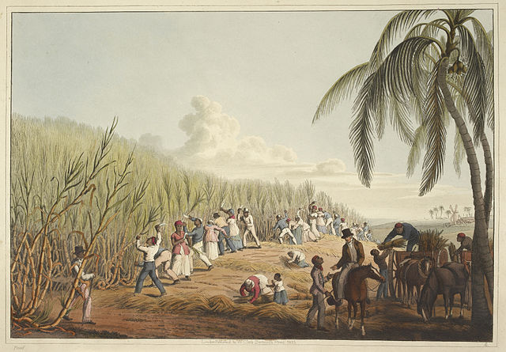
Growth of Slavery
Early on most enslaved Africans were brought to work sugar plantations in Brazil or the Caribbean

Slide 7
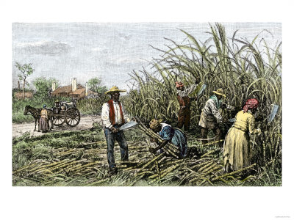
Portuguese Colonies
Worked under horrendous conditions
These conditions + diseases = very high death rate for enslaved peoples
About 5-10% of slave population died per year
Required the continuous importation of fresh slaves from Africa

Slide 8
Growth of Slavery
For the first few decades of English colonization there was not much use of slavery
Early English colonies used indentured servants instead of slave labor
Indentured Servants are temporary laborers that use work to pay off debts for

Slide 9
Growth of Slavery
This changed starting in English colonies in the 1670’s
The use of slavery forever changes ideas of race in Western culture
There were a few major reasons for the growth of reliance on slavery
We will be looking into this more tomorrow

Slide 10
Causes of Growth of Slavery
Early English colonies used indentured servants
Less people were volunteering to be indentured servants
This meant that many in the Southern Colonies needed to find a new labor force

Slide 11
Causes of Growth of Slavery
Slaves would never have to be freed or given land
Those who had been bringing indentured servants began to realize slaves were more “cost effective”
English writers began to discuss this as a way make as much profit as possible

Slide 12
Causes of Growth of Slavery
The creation of the Royal African Company made buying slaves easier in 1672
Prior to this colonist would have to go through the difficult process to purchase slaves from the Dutch or Portuguese

Slide 13
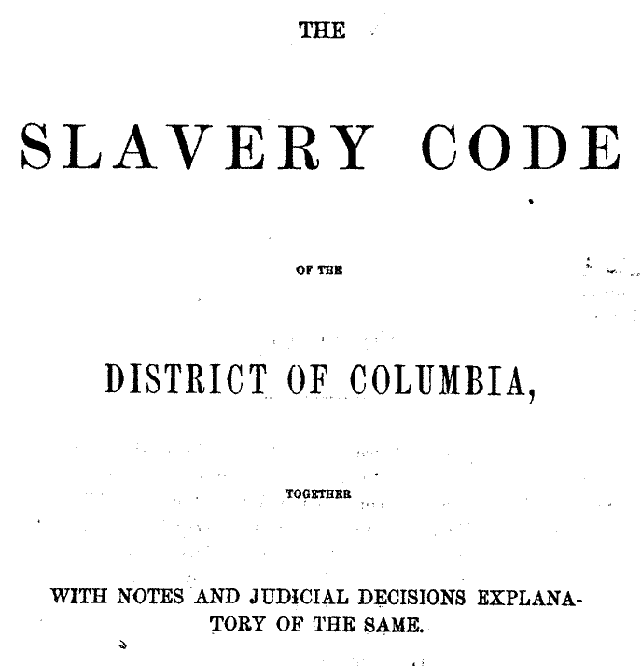
Causes of Growth of Slavery
The creation of Slave Codes better defined slavery and the treatment of slaves
These defined what position children of slaves were born into, the place of slaves, and the rights of masters
Slave codes helped to encourage the purchase of African Slaves

Slide 14
Slave Codes
Slave Codes greatly limited what slaves could do
Slave Codes forbade blacks to hold property, carry firearms, whites from teaching blacks to read & write, leaving property w/out master’s permission, or meeting with a white person present

Slide 15
The Middle Passage
A major part of the growth of slavery was the journey between Africa and the New World
This journey between Africa and the New World was known as the Middle Passage
It was an extremely brutal and terrifying experience for those people being forcibly transported to the New World

Slide 16
The Middle Passage
Between 10-12 Million Africans were brought to the Americas
It is difficult for scholars to even estimate the number of Africans that died during the Middle Passage
A voyage in which only one-quarter of the African captives died during the trip was considered a success.

Slide 17
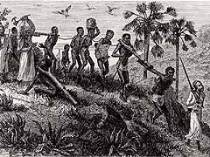
The Middle Passage
The best guess is that between one and two million persons died in the crossing
Slaves packed like cargo between decks often had to lie in each other's feces, urine, and blood.

Slide 18
The Middle Passage
We will be looking at some images and quotes on the Middle Passage
Let’s start out with the quotes

Slide 19
When I looked round the ship too and saw a large furnace of copper boiling, and a mulititude of black people of every description chained together, every one of their countenances expressing dejection and sorrow, I no longer doubted of my fate and quite overpowered with horrow and anguish, I fell motionless on the deck and fainted. . . . I asked if we were not to be eaten by those white men with horrible looks, red faces and long hair?“
Olaudah Equiano

Slide 20
"The closeness of the place, and the heat of the climate, added to the number in the ship, which was so crowded that each had scarcely room to turn himself, almost suffocated us. This produced copious perspirations, so that the air soon became unfit for respiration, from a variety of loathsome smells, and brought on a sickness among the slaves, of which many died."
Olaudah Equiano

Slide 21
The Slave Deck of the Bark “Wildfire”

Slide 22
Interior of a Slave Ship

Slide 23
Slave Deck of the Albatroz, 1845
by Lt. Francis Meynell

Slide 24
Diagram of a Slave Ship

