Slide 1
Interactive Notebook Setup
11/1/2018
Birth of King Cotton
This will be one page

Slide 2
Birth of the “Cotton Kingdom”
The “Cotton Kingdom”

Slide 3
The Birth of “Cotton Kingdom”
During the late 18th and early 19th century the South was undergoing massive changes
Like the Northeast these changes are largely influenced and caused by technology
The “cotton kingdom” was the cotton-producing region of the southern United States up until the Civil War

Slide 4
The Birth of “Cotton Kingdom”
“King Cotton” or the “cotton kingdom” would be the term(s) used to describe much of the South
In particular the deep South and the Southwest
The “cotton kingdom” expanded greatly after the Louisiana Purchase

Slide 5
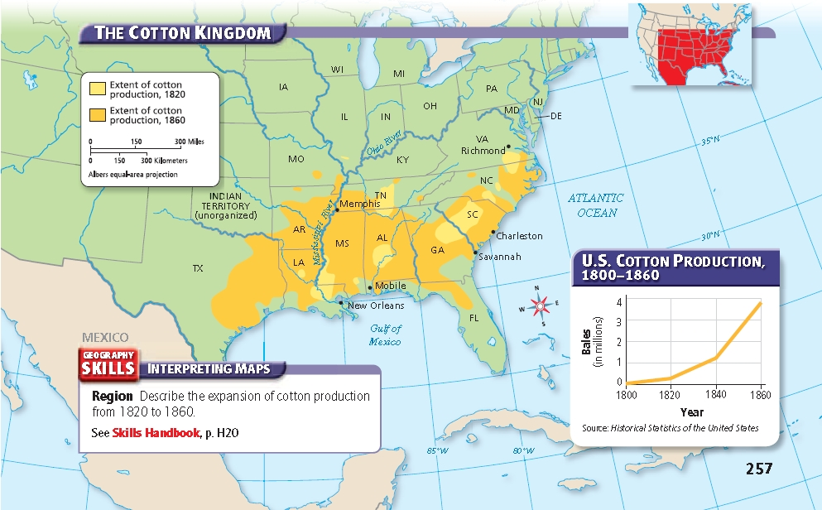

Slide 6
The Birth of “Cotton Kingdom”
Cotton was very time intensive to harvest and clean
Dependence on cotton and slavery had actually been declining in the 1780’s and 1790’s
Slavery and cotton production exploded with the invention of the cotton gin

Slide 7
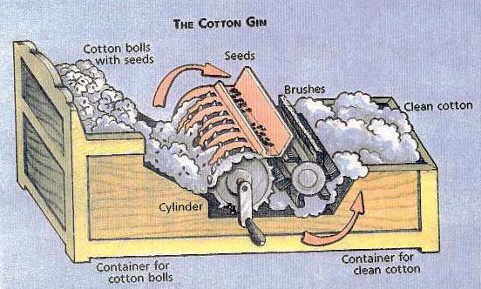
The Cotton Gin

Slide 8
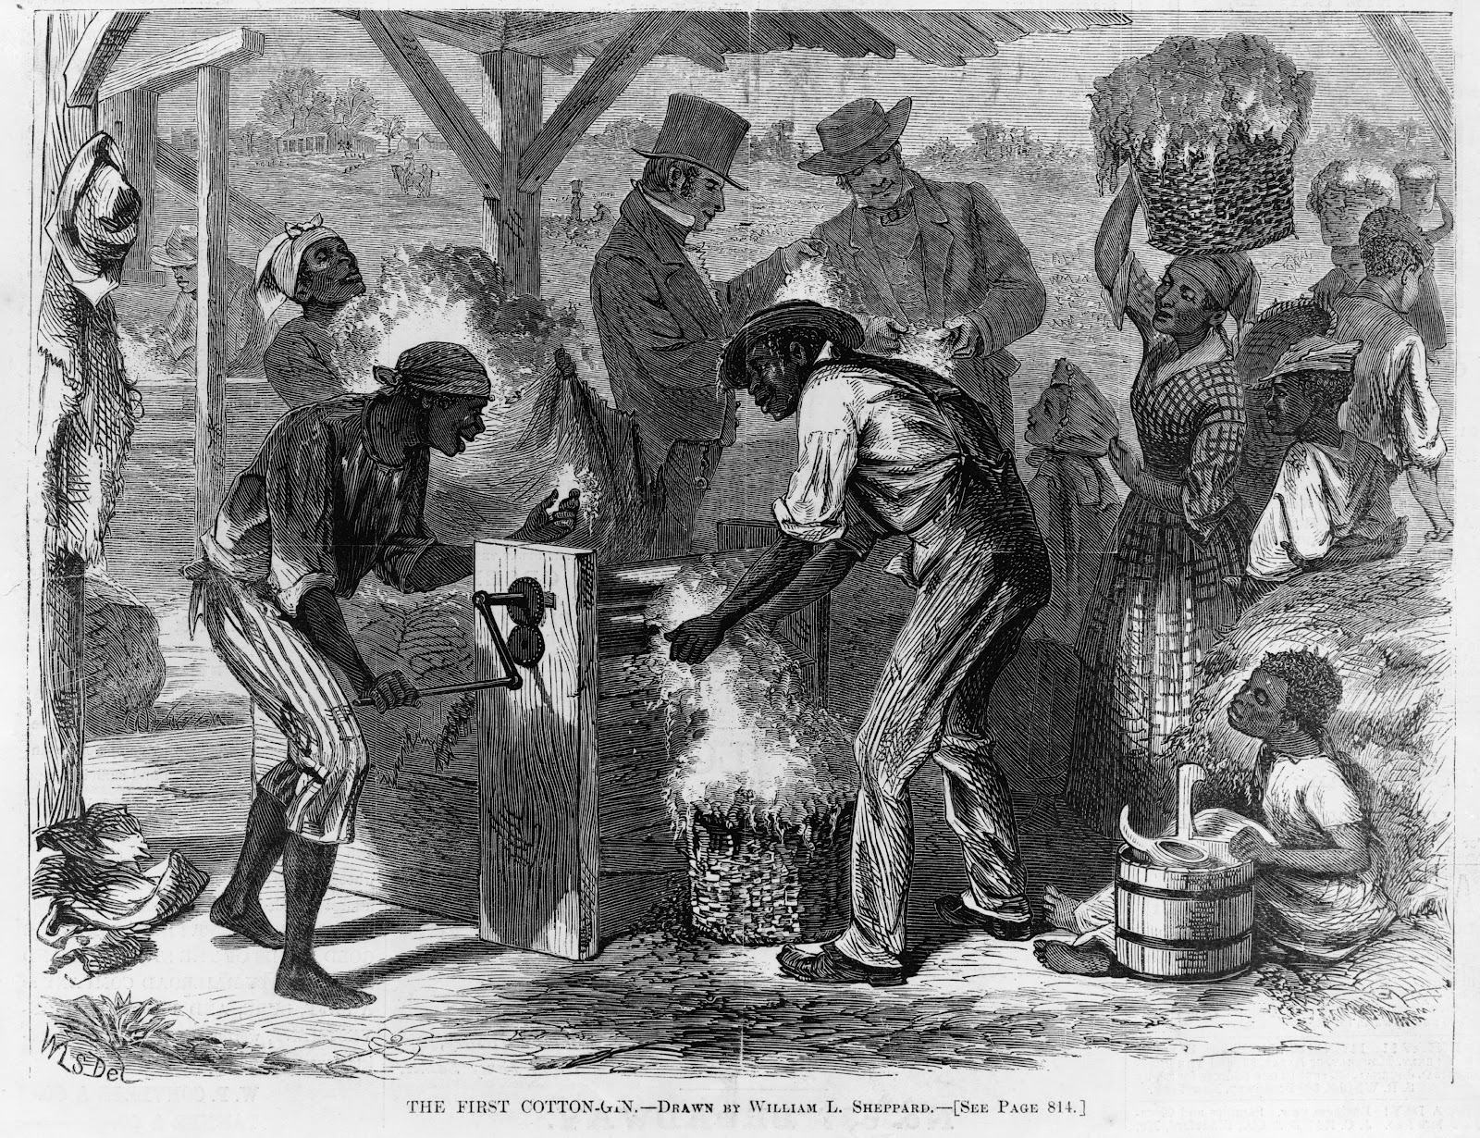
The Cotton Gin

Slide 9
The Birth of “Cotton Kingdom”
The invention of the cotton gin made cotton production easier
The growth of Northern textile production created a major market for Southern cotton
Britain was also dependent on Southern Cotton

Slide 10
The “Cotton Kingdom”
Cotton fueled the ENTIRE American market economy
Southern planters sold the cotton and used the income to purchase supplies from the West and goods and services from the North.
Northern factories made money by turning raw cotton into cloth and northern merchants profited from shipping the cotton and reshipping the finished textiles

Slide 11
The “Cotton Kingdom”
Slavery may have only be happening on a large scale in the South, but it truly was a NATIONAL institution because it impacted the Northern AND Southern economies
That is an incredibly important thing to keep in mind, slavery had influence throughout the entire nation!

Slide 12
The “Cotton Kingdom”
With the growth of cotton there was a shift of economic power from the "upper south" to the "lower south
Tobacco production in the “upper south” became more and more inconsistent
Tobacco devastated soil, which is why harvests were inconsistent

Slide 13
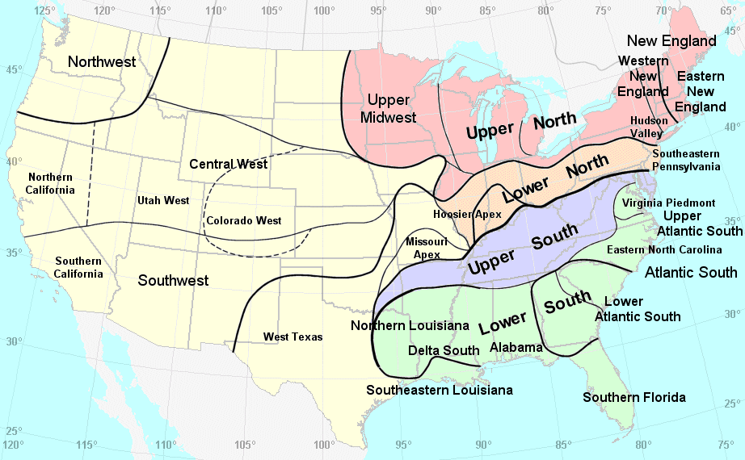

Slide 14
The “Cotton Kingdom”
The importation of slaves was banned in 1808
The “upper south” functioned as the slave trading region
Slave codes also helped to ensure that Southern plantations continued to have major slave populations

Slide 15
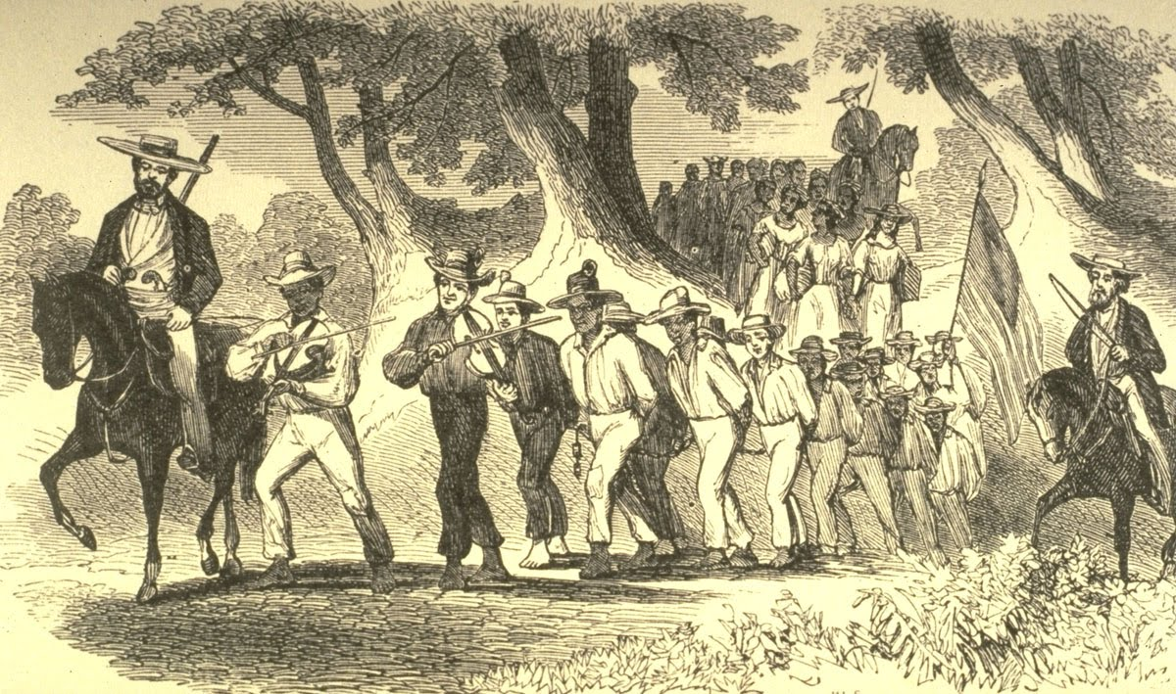
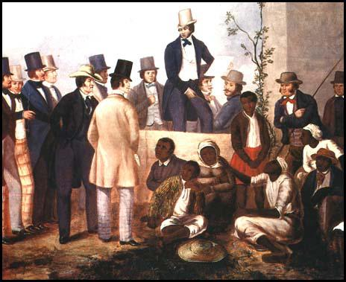
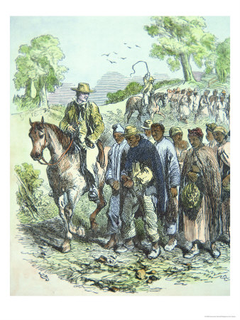

Slide 16
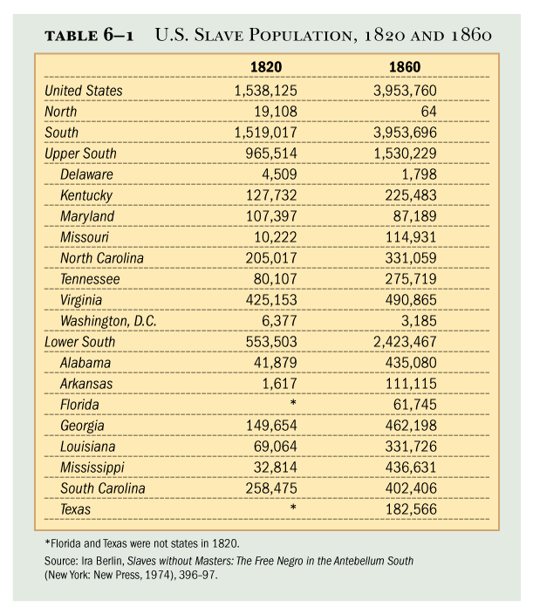
Because slave labor produced the cotton, increasing exports strengthened the slave system itself

Slide 17
The “Cotton Kingdom”
The South did not have the same levels of transportation develops as the North
This would be a HUGE factor in the Civil War
Almost all cotton exports traveled by sea and went through:
Mobile, Alabama
New Orleans, Louisiana
Charleston, South Carolina

