Slide 1
Columbian Exchange Bellwork
Can you think of any potential negatives of the development of the Columbian Exchange?
Answers Vary
Which of the items discussed yesterday are you most glad is now a global product?
Opinion
Notes:
tria

Slide 2
Themes Tuesday Bellwork
What is an example of State-Building, Expansion and Conflict in the Inca Empire?
Answers Vary
What is an example of Creation, Expansion and Interaction of Economic Systems in the Aztec Empire?
Answers Vary

Slide 3
Objective
WWBAT: Discuss the negative impacts of the Columbian Exchange and the development of system of Triangular Trade

Slide 4
Interactive Notebook Setup
8/15/2018
Impacts of Columbian Exchange and Triangular Trade
This will be one page

Slide 5
Dark side of Columbian Exchange
Triangular Trade/Atlantic System

Slide 6
Dark side of Columbian Exchange
The Columbian exchange was not limited to exciting items or food
There was also an exchange of diseases
Things like smallpox, malaria, measles, typhoid, scarlet fever, and the bubonic plague were not present in New World before Columbus arrived.
Notes:
a

Slide 7
Dark side of Columbian Exchange
Populations loss in the New World because of the introduction of these diseases is estimated to be between 50%-90%
On the island Columbus first arrived(Hispaniola) population went from 250,000 to 14,000 in 25 years

Slide 8
Dark side of Columbian Exchange
Slavery in many forms has existed for thousands of years
In one way almost every civilization has relied on slavery in some from
This means that slavery did not start with the enslavement of Africans in the 1400’s

Slide 9
Dark side of Columbian Exchange
Soon after the arrival Europeans Slave Trade was introduced to the New World
Initially the Spanish and Portuguese relied on the slave labor of native peoples
As early as 1502 there were African slaves brought to the New World
Called Chattel slavery
Solely the private property of the owner

Slide 10
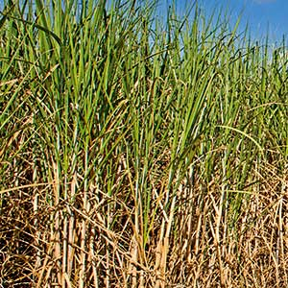
SUGAR CANE

Slide 11
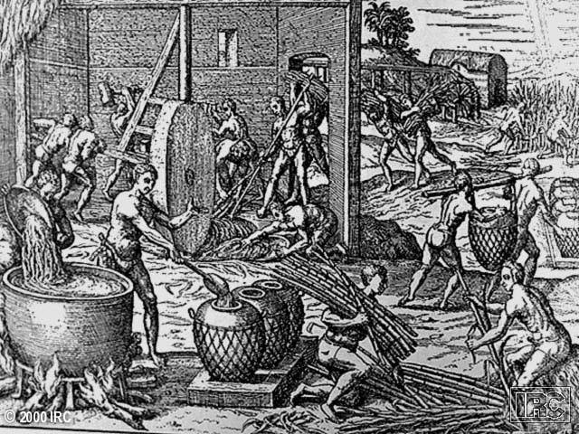
Slaves Working in a Brazilian Sugar Mill

Slide 12
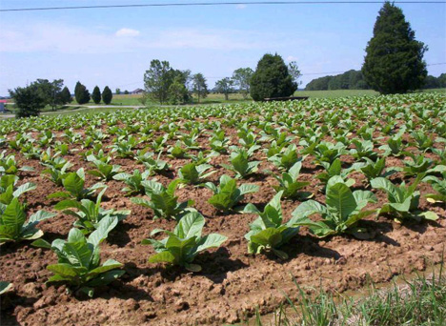
Raw Tobacco

Slide 13
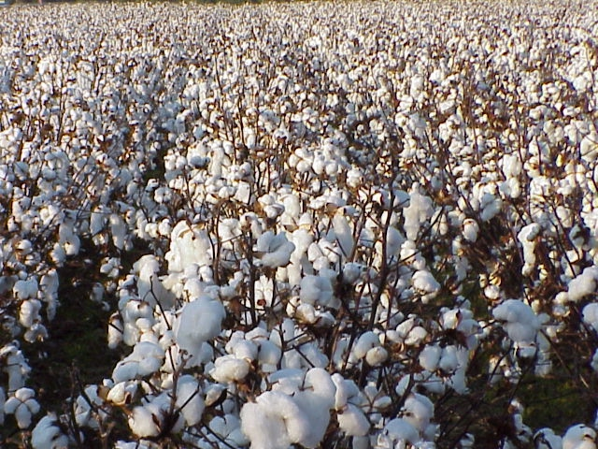
Raw Cotton

Slide 14
Triangular Trade/Atlantic System
The slave trade created what is called Triangular Trade
Trade between Africa, The New World, and Europe
This lead to the development of a major economic policy that would dominate Europe for 300 years

Slide 15
Triangular Trade/Atlantic System
Manufactured goods would be brought to African in exchange for the slaves
Slaves would be brought to the New World to work plantations producing raw materials
These raw materials would be brought to Europe and manufactured

Slide 16
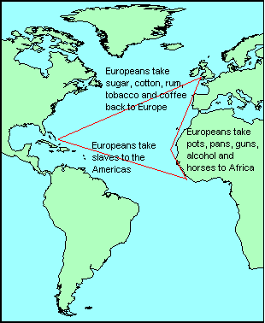
Triangular Trade

Slide 17
