Slide 1
Let’s Review
A few weeks ago we introduced the economic and political philosophy of mercantilism
Moving forward talking about the Navigation Acts as well as other economic policies of England mercantilism is going to be absolutely essential
Let’s talk for a minute to help remind us of some of the key ideas of mercantilism and triangular trade

Slide 2
Triangular Trade
One economic concept we discussed a little bit was the idea of triangular trade
Let’s take a minute to review triangular trade and work with some specific examples of what triangular trade can look like
Let’s check out a few definitions of triangular trade

Slide 3
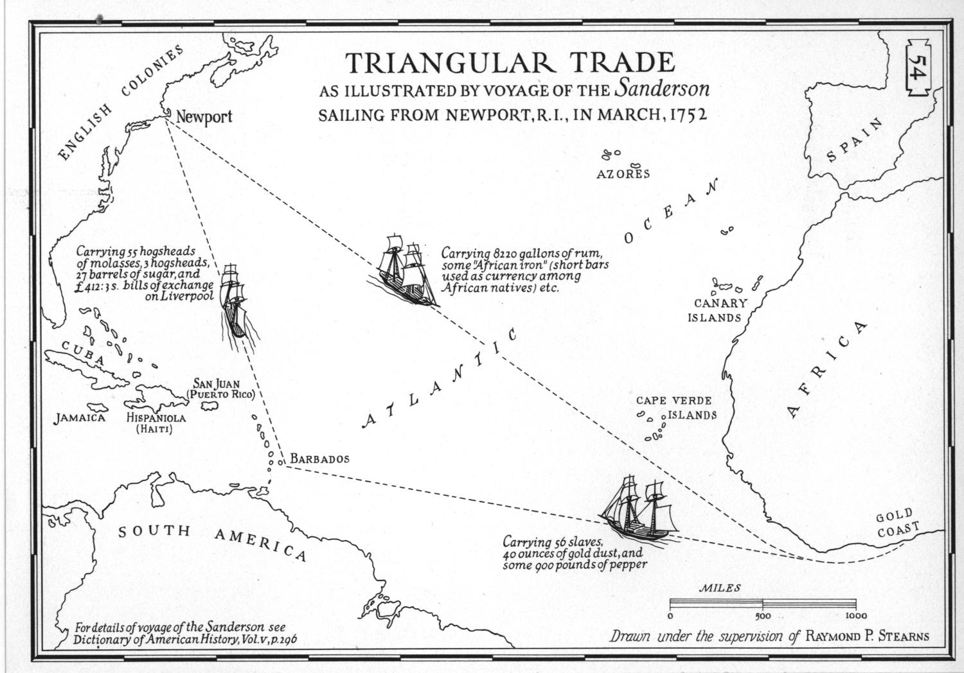

Slide 4
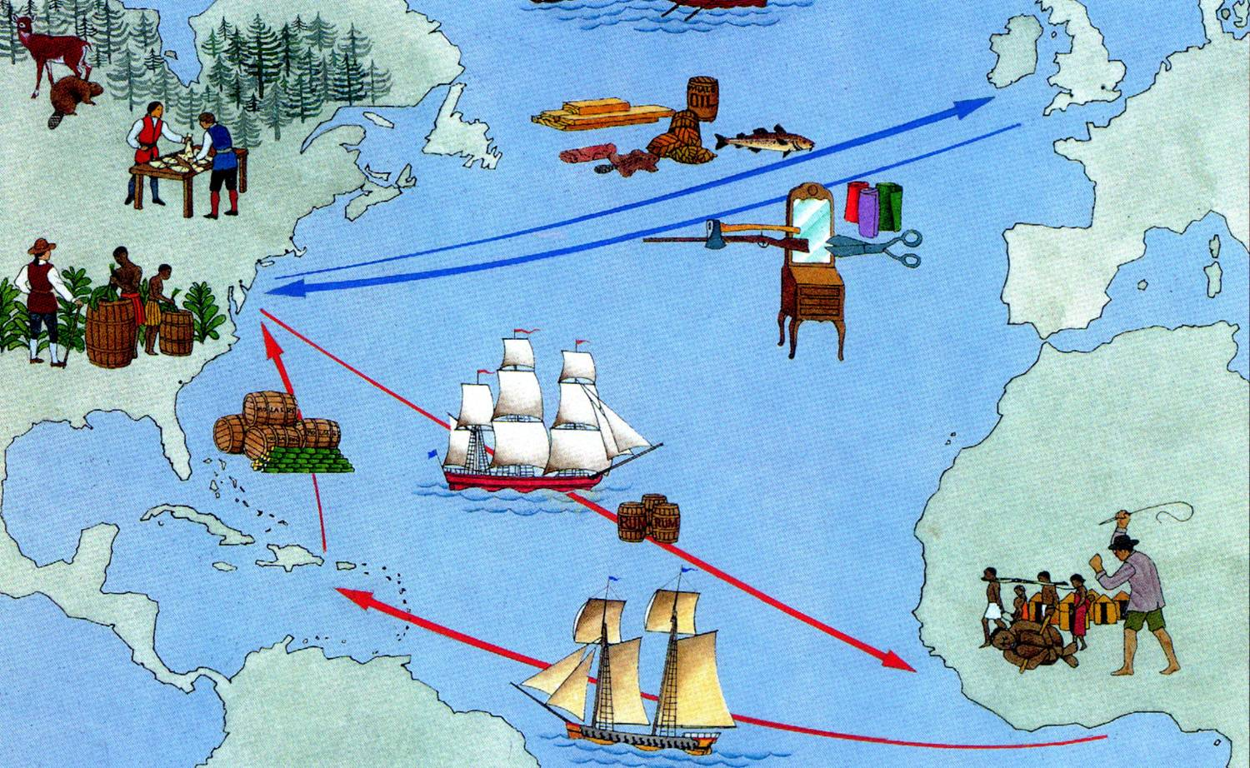
Triangular Trade

Slide 5
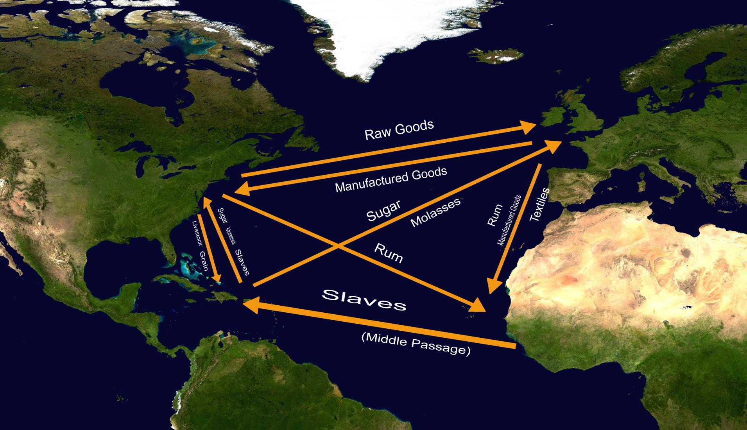

Slide 6
The Navigation Acts
The Navigations Acts are a series of laws dealing with trade in the colonies and in England
The first of the laws was passed in 1651 under the rule of Oliver Cromwell and the Commonwealth government
However there would be regular changes and additions to laws over the next decades

Slide 7
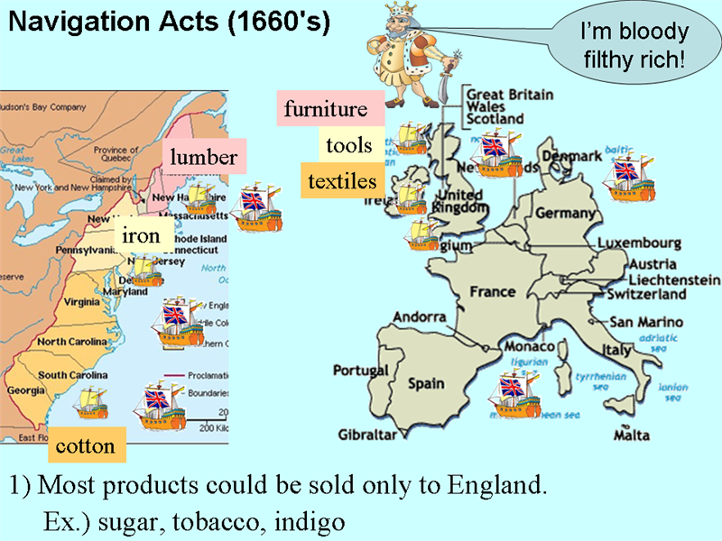
The Navigation Acts

Slide 8
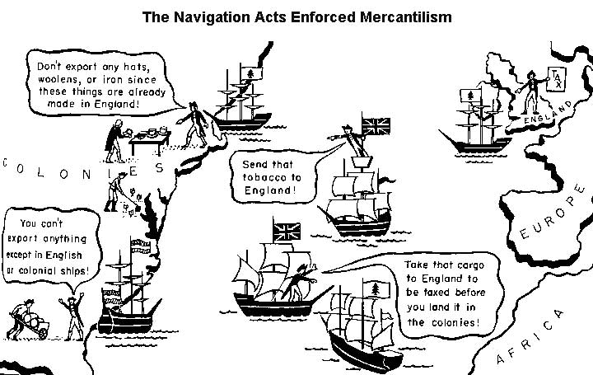
The Navigation Acts

Slide 9
The Navigation Acts
For the first years their existence, the Navigations Acts were not really enforced too strongly
Because England was going through so many problems and changes at home that they weren’t really too concerned with enforcing things like the Navigation Acts

Slide 10
Today’s Class
We will be looking at some scenarios relating to mercantilism and the Navigation Acts
You will be in groups thinking about and discussing the scenarios I will present you
Groups will be no more than 5 people

Slide 11
Today’s Class
For each of the scenarios there will be a few questions you will need to answer as a group
You will need to answer these questions in a few complete sentences
You will only need to turn in one set of responses per group

Slide 12
Let’s Look at the Scenarios
I will put up the scenario and then read them out loud
I will give your group a little bit of time to read and discuss the scenarios
I will then put up the questions you will need to be thinking about

Slide 13
Scenario # 1
You are a colonist living in one of the thirteen British colonies. While you would like to import tea from China, and sell various products you have grown in your colony to other countries, it is forbidden by the mother country. Items can only be purchased if they are imported from England and raw goods from the colonies can only be sent there to be sold. This means that you must pay a price set by the mother country and sell your items for a price they determine as well…….
Questions to consider….
1. How does this policy affect your personal income?
2. What might be a complaint you have regarding the ban on trade (both importing and exporting) with foreign countries?
3. How would you handle this situation?

Slide 14
Scenario # 2
You are the “Mother Country”. You rule a vast empire that includes various strategically placed colonies, which are utilized for their raw goods. You import the raw goods from your colonies and then process them into manufactured goods, which are sold for a high profit.
Questions to consider….
1. How does this policy affect your national wealth?
2. How do you think you would feel if your colonists wanted to trade with other foreign powers?
3. How would you handle this situation?

Slide 15
Scenario # 3
You are the captain of a ship that smuggles goods that have been banned by the Navigation Acts into and out of the English colonies. You make a high profit off of these goods because they are in such high demand both in the English colonies as well as in other parts of Europe. You run the risk of being captured and imprisoned if caught, but the profit from smuggling is too high to pass up….
Questions to consider…
1. How have these laws affected you, both personally and professionally?
2. Do you want to see mercantilist policies such as the Navigation acts continue, or would you like to see them repealed by England?
3. How would you handle this situation?

