Slide 1
Interactive Notebooks
11/14/2018
Northern Market Revolution
This will be one page

Slide 2
Northern Manufacturing
Transportation Revolution

Slide 3
Northern Manufacturing
The Northern United States became a power manufacturing area in the early 1800’s
Most important product was TEXTILES
They had learned about and really copies the British manufacturing

Slide 4
Northern Manufacturing
Manufacturing was totally dependent on Southern Cotton
This a big reason why Northern politicians DIDN’T work against slavery

Slide 5
Northern Manufacturing
Work in the factories drastically changed the way people lived
For the first time people’s lives were dictated by a clock and time
People needed to be at work at a certain time, take breaks at a certain time, and go home at a certain time

Slide 6
Northern Manufacturing
One of the first machines mass produced were clocks
Because time matters so much more while working in factory than when living on a farm

Slide 7
Northern Manufacturing
People began to be paid a wage, as opposed to a price
The amount of products made did not determine how much you made
The amount of TIME you worked is what determined your pay

Slide 8
Northern Manufacturing
For people working in factories leisure time and work time became very distinct
At the factory you worked and really only worked
At home you had free time and were able to more enjoyable activities

Slide 9
Northern Manufacturing
Not as much in the 1830’s and 1840’s, but more leisure activities developed due to more and more people working in factories
Once you left work you were done with work
The evening was you time to read(if you could), go to a pub, go to a show, etc.

Slide 10
Northern Manufacturing
Improvements in farming technology and transportation of crops meant that less farmers were needed
Northern cities became much larger than in the South and MUCH more diverse
Generally people made more money working in factories than they had previously made on their farms

Slide 11
Market Revolution Facts
In 1817 New England’s textile mills produced 4 million yards of cotton cloth. 1840 it was 323 million.
In 1820 there were 12 cities in America that had a population of 5,000 people. In 1850 there were 150 cities with a population of 5,000 people
The journey from Ohio to N.Y. in 1815 took 52 days. The same route by 1850 took 6 days.

Slide 12
Impacts of Market Revolution
The number of cities exploded
In 1820 there was only one cities with a population of 100,000 by there 1860’s there would nine
In 1820 New York had 123,706residents and in 1860 New York had 813,669

Slide 13
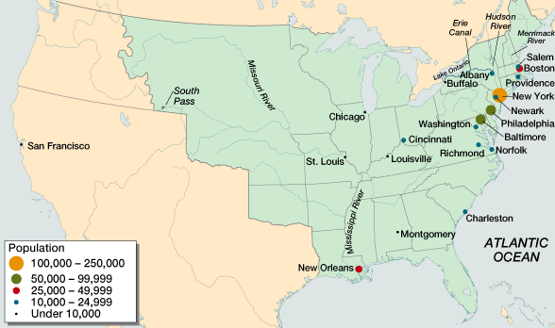
American Population Centers in 1820

Slide 14
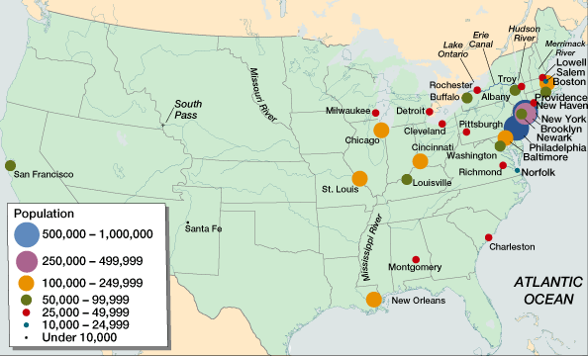
American Population Centers in 1860

Slide 15
Northern Manufacturing
Immigration to the U.S. increased during the Market Rev.
Immigrant came seeking work in factories
In some cases immigrants replace workers because they worked for less
In other cases they filled gaps left when people moved West

Slide 16
Roads!
At the beginning of the 1800’s there was little in the way of roads in the U.S.
There were no national roads
In the early decades of the 1800’s this began to change with the building of turnpikes

Slide 17
Transportation Revolution
In the late 1790’s private company began building turnpikes
These roads generally connected commercial centers
Turnpikes/Roads cost money to use

Slide 18
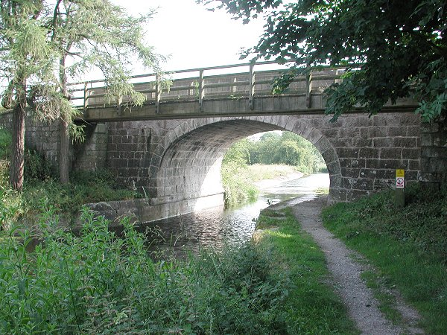
Lancaster Turnpike

Slide 19
Transportation Revolution
British blockades during the war of 1812 showed many Americans how inadequate their roads were
In 1811 work began on the first “National Road”
This road connected the Potomac and Ohio Rivers

Slide 20
Roads!
Eventually this road would be expanded and go essentially to the Mississippi River
Roads were useful for short transportation and moving small amounts of goods, but other forms of infrastructure would prove to be far more important

Slide 21
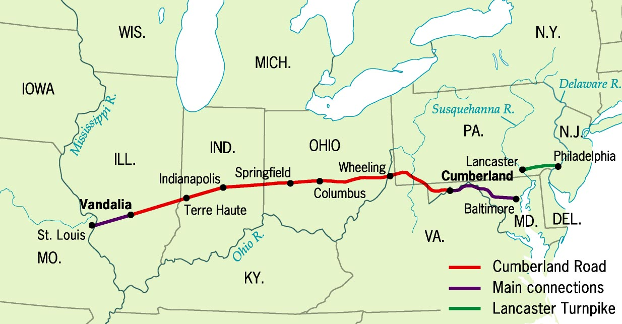
National Road(Cumberland Road)

Slide 22
Transportation Revolution
Canal were much more useful than roads
By using canals goods could be transported more easily and in greater quantity
The growth of the use of steamboats would further make canals more important

Slide 23
The Erie Canal
1st major engineering feat in America.
Supported by the New York City Merchants, Gov. DeWitt Clinton, and the tax payers.
Moved millions of cubic yards of dirt, quarry rocks and build locks to raise and lower boats

Slide 24
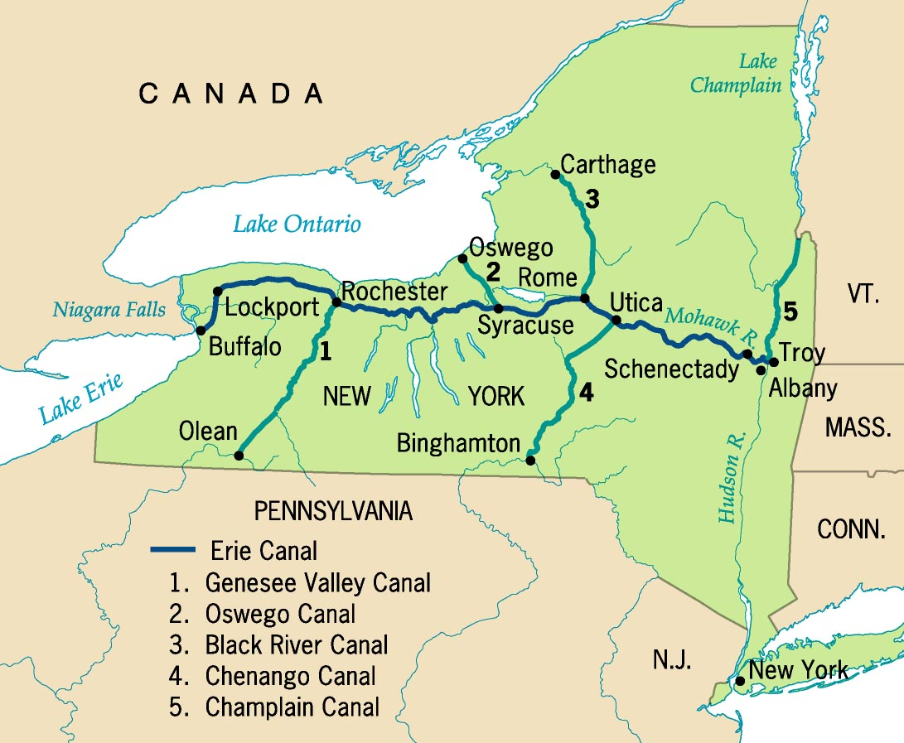
Erie Canal System

Slide 25
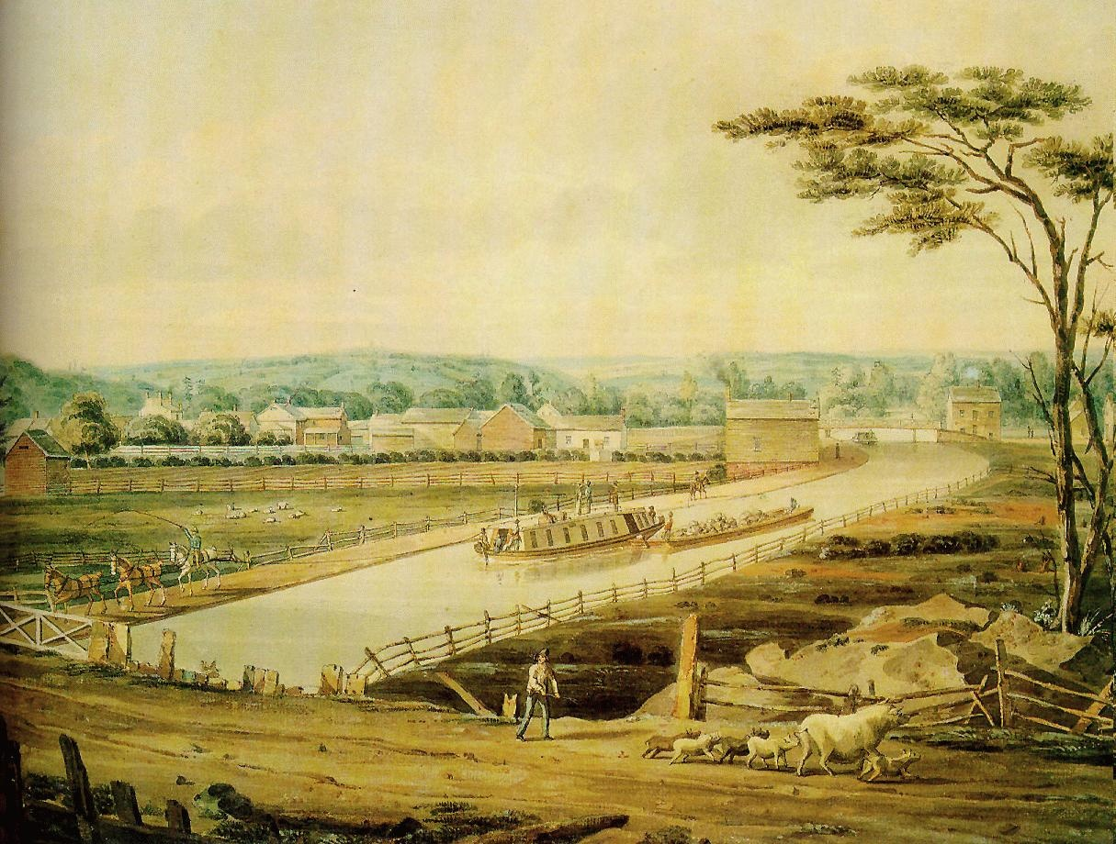
The Erie Canal, 1820s

Slide 26
The Erie Canal
The Erie Canals is 363 miles long!
Brought prosperity to central and western New York
Towns and industries developed along the route
Led to a canal building boom

Slide 27
Canals!
Before the Erie Canal was built it cost 19 cents a ton per mile to ship over land
By 1830, the cost to ship goods had fallen to less than 2 cents a ton per mile
This all started with the construction of the Erie Canal

Slide 28
Canals!
When construction on the Erie Canal began in 1817 there was a total of about 100 miles of canals in the U.S.
By 1840 there were be over 3,000 miles of canals in the U.S.

Slide 29
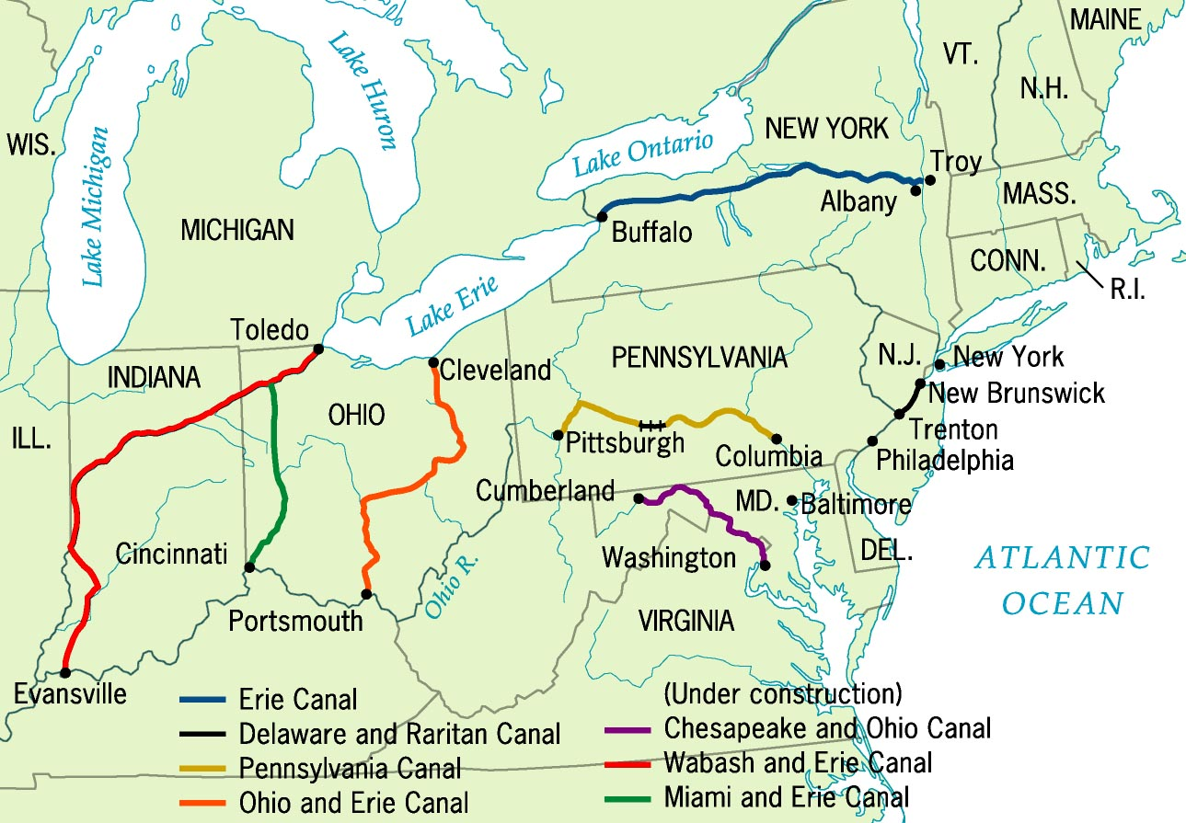
Major Canals in 1840

Slide 30
Transportation Revolution
Railroads also proved to be more useful than roads
Like canals railroads lines could carry major loads, much more quickly
Railroads became most important form of transportation

Slide 31
Transportation Revolution
The first important railroad company was created in 1828 and called The Baltimore & Ohio Railroad company
This railroad was created to connect the Baltimore port to the Ohio River
Railroads would help maintain Baltimore as one of the most important port cities in the U.S.

Slide 32
