Slide 1
Objective
WWBAT: Introduce and discuss the similarities and differences in the regional slavery

Slide 2
Interactive Notebook Set Up
8/30/2018
Slavery in the Colonies
This will be on one page

Slide 3
Southern Slavery
Northern Slavery

Slide 4
Southern Slavery
The Southern economy was almost ENTIRELY based on agriculture
Small farms and large plantations grew:
Corn
Wheat
Tobacco
Cotton

Slide 5
Southern Slavery
Slaves in the Southern colonies worked primarily on small farms and plantations
This kind of field work was extremely labor intensive
Plantations owners often relied on large numbers of slaves to work their large land holding

Slide 6
Southern Slavery
After the 1670’s the number of slaves in Southern Colonies began to grow rapidly
Eventually slaves would make up HUGE portions of the colonies population
By 1710 in Virginia 42% of the population and 23% of Maryland’s population were slaves

Slide 7
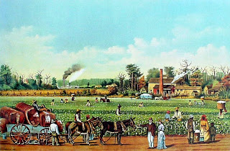
Southern Plantations

Slide 8
Southern Slavery
Conditions were the worst for slaves in the Southern Colonies
Due in large part to the introduction of Slave Codes
In some colonies it was illegal to free slaves

Slide 9
Southern Slavery
Because the introduction of slave codes, slaves began to be viewed and treated as property
This meant that slaves could be used as currency
Slaves could also be used as collateral to get loans and purchase land
This also meant that slaves could be sold and traded freely and easily

Slide 10
Southern Slavery
In Southern colonies, slave owners were somewhat concerned about slaves health
Slave owners sometimes encouraged slaves to form families and reproduce
This was mostly to protect their investment and ensure growth of their slave population

Slide 11
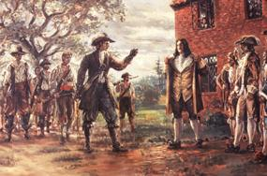
Southern Slavery
By the 1700’s the Southern Colonies had developed into a slave society
After Bacon’s Rebellion there was great class tension in the Southern Colonies

Slide 12
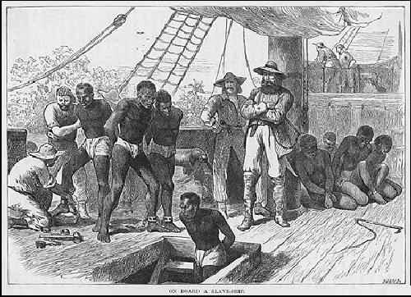
Southern Slavery
There are many historians who theorize that part of the reason for the growth of African slavery was a conscious effort to create racial solidarity amongst white citizens

Slide 13
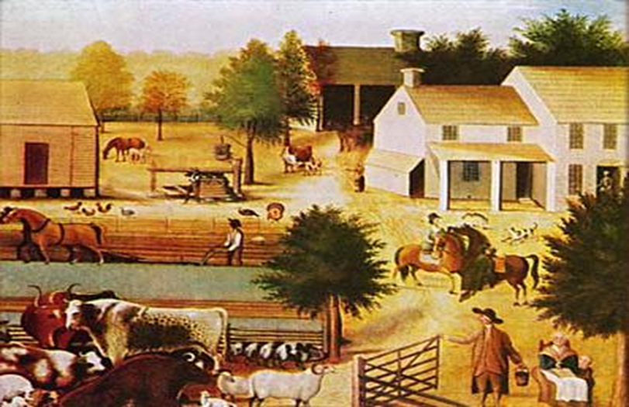
Northern Slavery
Economy was based on small farming, ship building, lumber, and fishing/whaling
There were NO large planation's in Northern Economies

Slide 14
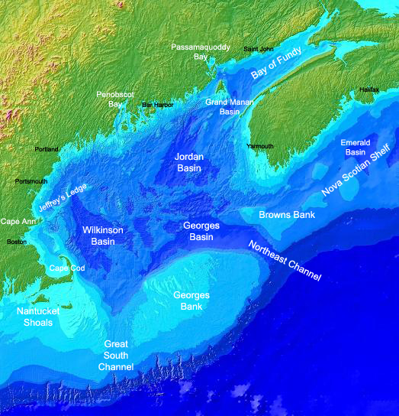
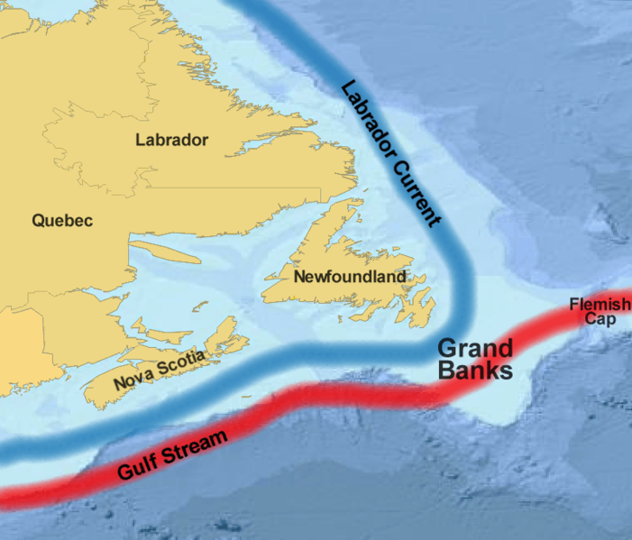
The Georges Bank and the Grand Banks

Slide 15
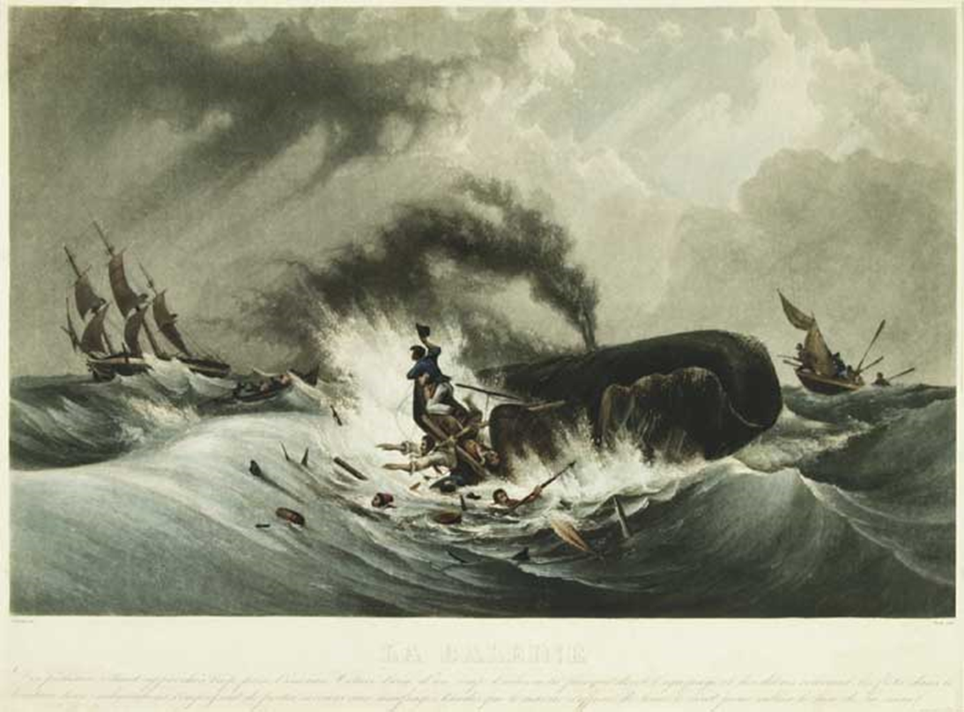

Slide 16
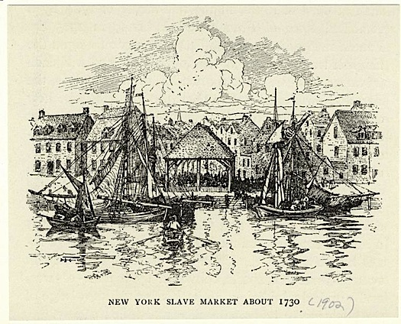
Northern Slavery
Slavery was not as large a part of the labor force, in the North
But, slavery did play a large role in the Northern economy
Slavery was considerably different in the Northern colonies

Slide 17
Northern Slavery
Northern slaves worked in numerous different crafts and industries
There are records of slaves working in masonry, shipbuilding, farming, lumber, goldsmiths, etc.
Often times slave owners and slaves would work with oneanother

Slide 18
Northern Slavery
Slavery was legalized in Northern colonies before any Southern colony
Massachusetts was the first colony to pass a law allowing slavery
In 1641 the Massachusetts Bay Colony permitted slavery when the “Bodies of Liberties” was passed

Slide 19
Northern Slavery
Plymouth and Connecticut allowed slavery in 1643
Rhode Island allowed slavery in 1652
New York and New Jersey allowed slavery in the 1660’s
Pennsylvania allowed slavery in 1700
Only 18 years after its formation

Slide 20
Northern Slavery
Most Northern slaves tended to work in urban environments
This is because Northern colonies did not lend themselves to large plantations because of climate as well as geography
Most slave owning families would own around 2 slaves

Slide 21
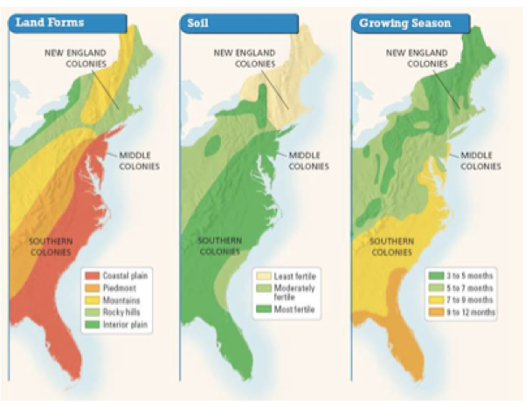

Slide 22
Historian Edgar J. McManus’ view on the social status of Northern Slavery
Slaveholding reflected social as well as economic standing, for in colonial times servants and retainers were visible symbols of rank and distinction. The leading families of Massachusetts and Connecticut used slaves as domestic servants, and in Rhode Island, no prominent household was complete without a large staff of black retainers. New York's rural gentry regarded the possession of black coachmen and footmen as an unmistakable sign of social standing. In Boston, Philadelphia, and New York the mercantile elite kept retinues of household slaves. Their example was followed by tradesmen and small retailers until most houses of substance had at least one or two domestics

Slide 23
Northern Slavery
In many Northern colonies owning slaves was a status symbol as much as an economic investment
There are numerous examples of Northern slave owners discussing owning black servants, valets, and coachmen as a symbol of their wealth and status

Slide 25
Respond to the Following Questions
On a half sheet of paper answer the following questions:
How does the quote from McManus demonstrate owning slaves as a status symbol in the North?
In what ways was slavery different in the Northern and Southern Colonies?

Slide 26
Regional Slavery Bellwork
By 1700 the South became a _____________
Slave Society
Why did slave owners provide some medical care/treatment for enslaved people?
Protect their investment, make sure people can work

Slide 27
Objective
WWBAT: Introduce and discuss the similarities and differences in the regional slavery

Slide 28
Regional Slavery Bellwork
Why did people tend to own slaves in the Northern Colonies?
As a social status symbol
Why did conditions get worse for enslaved people in the Southern Colonies?
Slave Codes

