Slide 3
Enlightenment Bellwork
What does the famous phrase “Life, Liberty, and the Pursuit of Happiness” mean to you?
Opinion
What does the following quote mean to you?
“All things must be examined, debated, investigated without exception and without regard for anyone’s feelings” Diderot
Opinion

Slide 4
Great Awakening Bellwork
Think about all three sources we read for this question
Why was George Whitefield so popular?
Opinion

Slide 5
Objective
WWBAT: Introduce and summarize the ideas of major Enlightenment thinkers and discuss their impacts on the ideas of American government

Slide 6
Today’s Class
We will begin our examinations of WHY the American Revolution took place
Today we will be looking at how major philosophers influenced the ideas of people leading up to the Revolution
These thinkers are all part of the Age of Enlightenment

Slide 7
Interactive Notebook Set Up
9/13/2018
The Enlightenment and America
This will be one page

Slide 8
Reasons & Philosophes
Background
Hobbes
Hobbes
Locke
Locke
Montesquieu
TWEET
TWEET
Montesquieu
Rousseau
Smith
TWEET
TWEET
TWEET

Slide 9
Background
The Enlightenment was a philosophical movement that attempted to improve:
  Government/Politics
  Economics
  Religion and Morality

Slide 10
Background
The Enlightenment stressed that Reason and logic could help better understand the world
The American Revolution would test out many ideas of the Enlightenment

Slide 11
Background
They attacked laws, institutions, and practices
Everything that they considered to be unreasonable or unnatural
The Philosophes believed that the people had the capability to make changes that would make life better
Their view of the future was generally bright

Slide 12
Background
The intellectuals who adopted this position were called Philosophes
The philosophes were social critics, publicists, political scientists, economists, and social reformers
Their ideas would influenced the beliefs of the founding fathers

Slide 13
What To Do
I will be providing some background info on some important Philosophes
You are to summarize the thoughts of each Philosophe into a Tweet or Tweets
This means you have 280 characters to summarize their thoughts!
You can either summarize or tweet as if you were this philosopher

Slide 14
What To Do
Embrace the goofiness and have some fun
  Throw in #’s, @ other philosophers and thinkers, ect
If you have a twitter account feel free to ad your philosophers tweets to the thread I started on @pfannenhistory & use the #CRUSPF

Slide 15
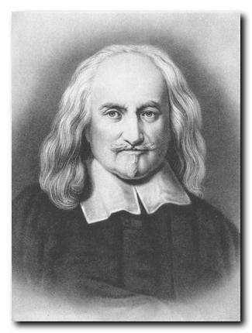
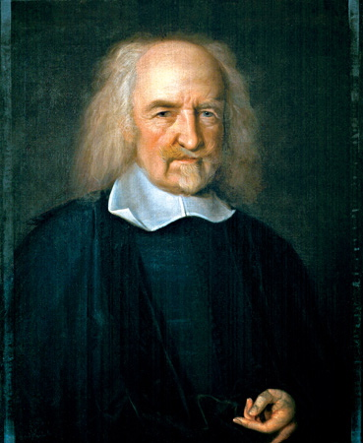
Thomas Hobbes

Slide 16


Thomas Hobbes
Believed in the social contract
People should give up individual liberties in return for social order
The natural condition of humans is one of continuous conflict and competition
Supporter of absolute monarchy
The monarchy would help to keep social order

Slide 17
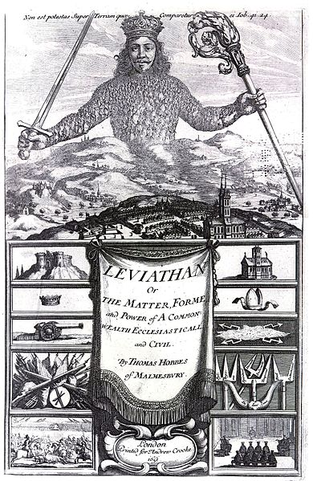
Thomas Hobbes
Believed anarchy to be a state of nature.
Wrote Leviathan (1651)
Leviathan or The Matter, Forme and Power of a Common Wealth Ecclesiasticall and Civil
Said life is “solitary, poor, nasty, brutish, and short”.

Slide 18
John Locke

Slide 19

John Locke
Believed in individual rights that couldn’t be surrendered
  – Life
  – Liberty
  – Property
People would not and could not willingly surrender their fundamental natural rights.

Slide 20
John Locke
Government existed to protect those rights, & if they didn’t, it should be overthrown.
Rebellion is the right of the people because people have the gift of reason
Supporter of Democracy
Wrote Two Treatises on Government

Slide 21
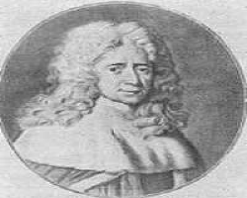
Baron de Montesquieu

Slide 22
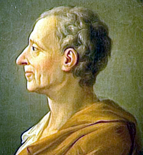
Baron de Montesquieu
Division of power into 3 branches
  Executive
  Legislative
  Judicial
No branch should be too powerful
  CHECKS AND BALANCES

Slide 23
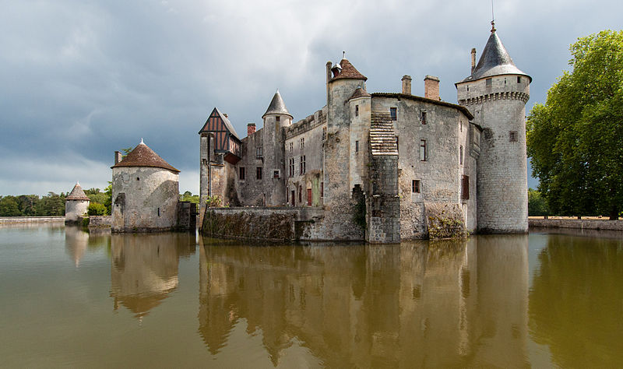
Baron de Montesquieu
Saw humans life as a comedy and satire
Form of government should be based on what people need at that time
Published The Spirit of the Laws (1748)

Slide 24
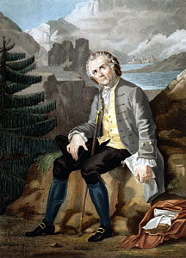
Jean-Jacques Rousseau

Slide 25
Jean-Jacques Rousseau
Believed in Popular Sovereignty
  All power should come from the people
Argued people are naturally good, but society corrupts them through environment, education and laws.
Opposed strong government

Slide 26
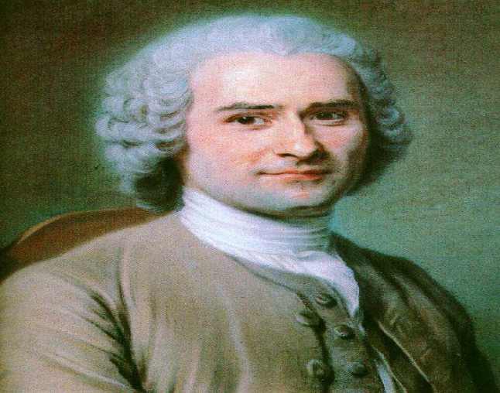
Jean-Jacques Rousseau
Government created and controlled by the people.
Did not trust reason, believing that it brought corruption and misery.
Published The Social Contract (1762)

Slide 27
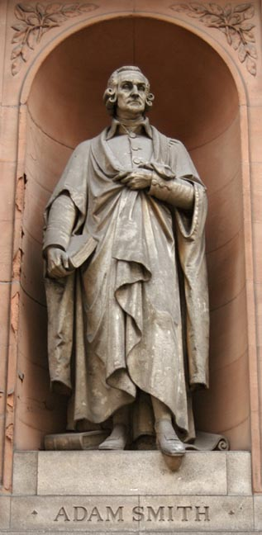
Adam Smith

Slide 28
Adam Smith
Government should allow economic liberty & freedom
  Called laissez-faire.
Shouldn’t control economy
He greatly opposed many of the principles of Mercantilism

Slide 29
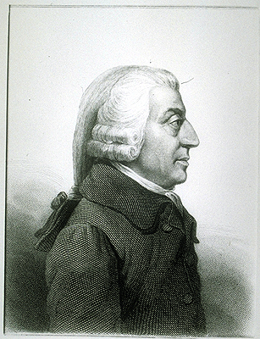
Adam Smith
Free trade, Market economy, Supply and demand
Believed in Self interest, Competition, and Everyone is selfish
Wrote The Wealth of Nations (1776)

Slide 30
What To Do
I will be providing some background info on some important Philosophes
You are to summarize the thoughts of each Philosophe into a Tweet or Tweets
This means you have 280 characters to summarize their thoughts!

Slide 31
What To Do
Embrace the goofiness and have some fun
Throw in #’s, @ other philosophers and thinkers, ect

